Slide 1
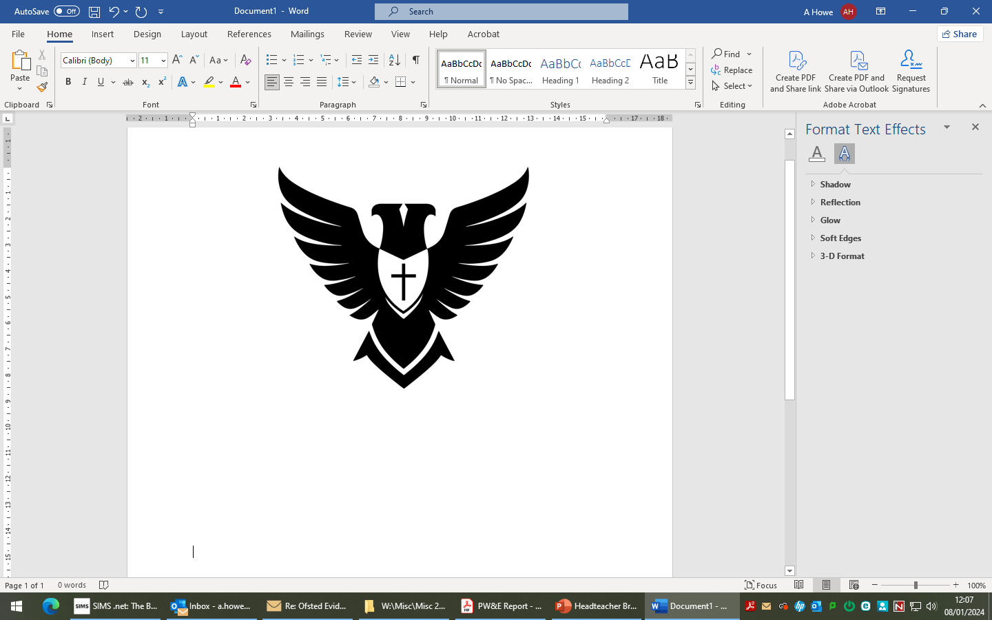
Parents’
Forum

Slide 2
Revision at KS3 - Overview
Half Term | Half Term Focus
1
2 | Revision
3 | Big Tests (week beginning 12th January)
4 | Revision
5 | Big Tests (week beginning 1st June)
6

Slide 3
What we did in 2024 - 2025
Clear communication to parents (half a term in advance) to inform them of The Big Tests and share strategies to support their child to revise.
Shared revision lists to pupils and parents.
Shared some extra revision materials for some subjects.
Consistent approach on Teams
Created the revision hub.

Slide 4
Pupil and Parent Voice
1. Revision Resources (Format & Access)
Strong demand for paper-based resources (not QR codes/online only).
Ensure consistency across subjects – some subjects thorough (English, RE, History, Computing), others weak (Spanish, Science).
Add knowledge organisers, worked examples, practice questions.
Materials must be SEND-friendly and accessible for all (including families without printers/internet).
2. Timing & Organisation
Revision packs should be given earlier (not just before half term).
Exams ideally held second week back after holidays, not first.
Spread exams over more days to avoid multiple in one day.
Avoid changes to teachers/sets/forms close to tests.
3. In-School Revision
More revision lessons in class and opportunities after school.
Dedicated library/revision clubs for quiet supervised study.
Incorporate mock questions & exam technique practice into lessons.
“Little and often” revision in class to prevent overwhelm.

Slide 5
Pupil and Parent Voice
4. Practice & Feedback
Provide past papers, sample questions, step-by-step solutions.
More individual feedback highlighting learning gaps.
Share exam papers & mark schemes with parents to support at home.
Mini-tests/quizzes throughout the year to track progress.
5. Support for Pupils
Teach pupils how to revise effectively (strategies, timetables).
Extra targeted help for those struggling in core subjects (Maths, Science, Spanish).
SEND pupils need adjustments and tailored support (quiet spaces, simplified guides).
Provide engaging/fun revision methods to boost motivation.
6. Support for Parents
Clearer communication on what resources children have and how to use them.
Share revision timetables & topics tested.
Give parents guidance/training on supporting revision at home.
Provide regular progress updates so parents know where their child needs help.

Slide 6
Moving forward
Communication to parents (with notice) to inform them of The Big Tests and share strategies to support their child to revise will continue.
Moved January Big tests to second week back.
Shared revision lists to pupils and parents.
Improve the quality of the resources.
Consistent approach in all subjects. Our revision hub now contains for each subject:
Revision list
Knowledge Organiser
Activates to complete
Support on how to revise
Greater support in teaching pupils (and parents) how to revise.

Slide 7

Improving independent revision

Slide 8
Building on previous success
Revision Hub ​
Revision resources available to pupils​ ​
Introduction of revision strategies last year

Slide 9
Aims of Technique of the Week
To explicitly teach pupils how to revise
To provide whole-school and subject-level support on how to revise
Pupils feel better prepared and demonstrate improved attainment and progress in the Big Tests

Slide 10
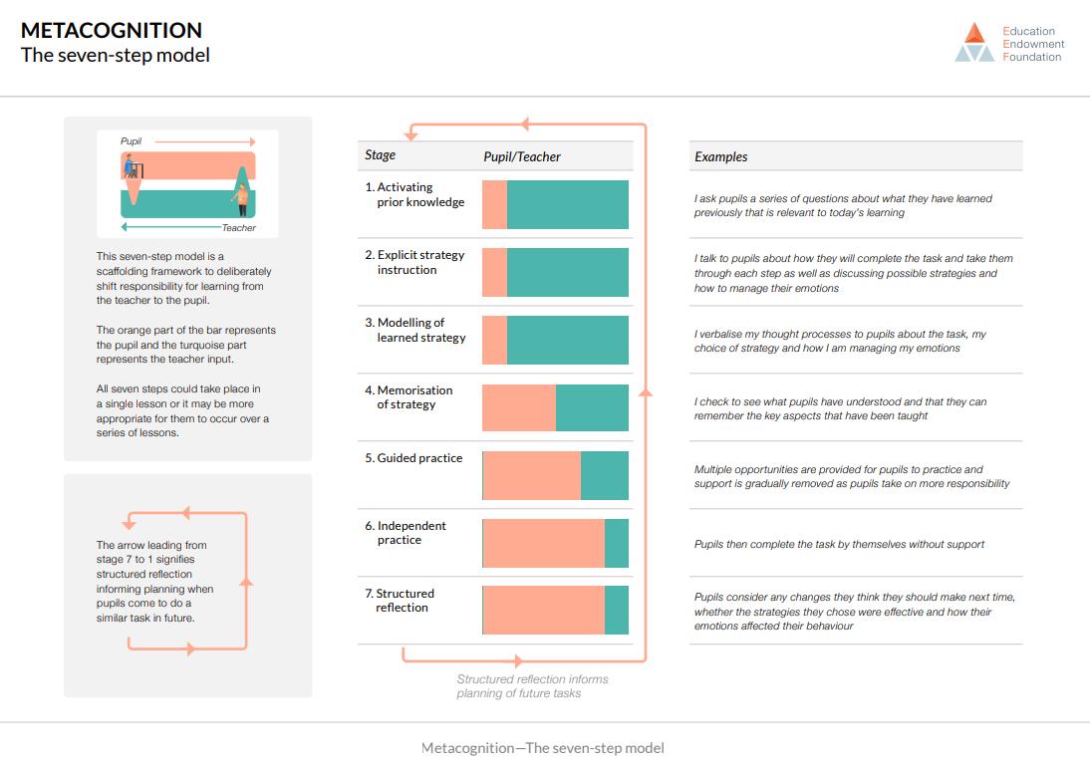
EEF 7-step model on how to teach revision strategies

Slide 11
Technique of the Week
Weekly revision technique as a focus
Input from family time and in subject lessons
Week beginning | Technique of the Week
3rd November | Revision timetable
10th November | Flashcards
17th November | Revision lists
24th November | Knowledge organisers
1st December | Quizzes
8th December | Cornell notetaking
15th December | Revising with friends and family

Slide 12
Each Friday family tutors will share the following week's Technique through the shared slides and video.
Throughout the w/c of the Technique, teachers will spend a max of 5-10 mins providing subject-level expertise on how to apply the Technique.
Pupils will try the Technique at home with support on the Revision Hub.
Technique of the Week
Steps 1-3
Steps 4-5
Steps 6-7

Slide 13
Technique of the Week
Timetable

Slide 14

Technique of the Week
w/c 3rd November: Timetable
Discuss with your shoulder partner:
When have you created a revision timetable before?
Do you remember what to include in a revision timetable?
Then watch this video to learn how to use the technique.

Slide 15
Technique of the Week
w/c 3rd November: Timetable
What next?
You will be shown how to apply this technique to your different subjects in lessons after half term.
You should then practice the technique at home.
Want to see the video again? Check out the Revision Hub.

Slide 16
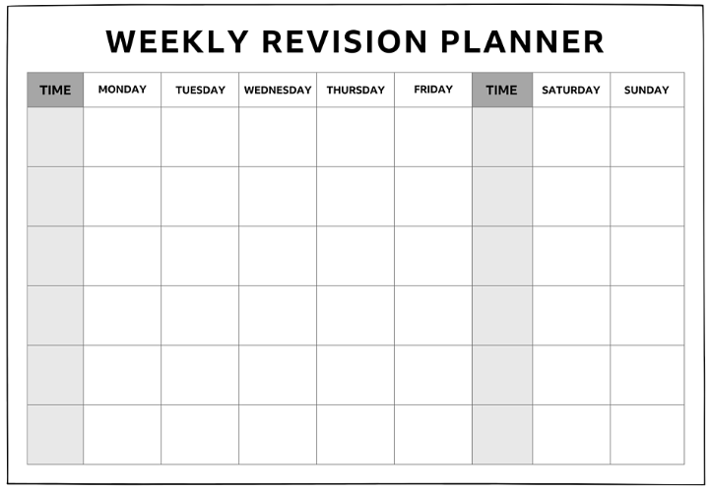
Each family tutor to collect today and hand out tomorrow morning.
Tomorrow's session is slightly different.

Slide 17

Technique of the Week
w/c 3rd November: Timetable
What does this look like in SUBJECT?
Can you recall how to create a revision timetable?
Let’s look at how to apply this technique to SUBJECT.

Slide 18
Technique of the Week
Flashcards

Slide 19

Technique of the Week
w/c 10th November: Flashcards
Discuss with your shoulder partner:
When have you used flashcards before?
Do you remember how much information you should write on them?
Then watch this video to learn how to use the technique.

Slide 20
Technique of the Week
w/c 10th November : Flashcards
What next?
You will be shown how to apply this technique to your different subjects in lessons this week.
You should then practice the technique at home.
Want to see the video again? Check out the Revision Hub.

Slide 21
Technique of the Week
w/c 10th November : Flashcards
What does this look like in SUBJECT?
Can you recall how to create quality flashcards?
Let’s look at how to apply this technique to SUBJECT.

Slide 22
Actions and next steps
Family Tutors to launch the first Technique of the Week tomorrow on Revision timetables.
Family Tutors to collect a pile of blank revision timetables to hand out tomorrow.
Teachers to plan in 5-10 minutes during the first week back to explicitly show students how to apply the Technique of the Week to their subject.
On Friday 7th November the second Technique is launched in Family Time (Flashcards) and the process repeats.
Staff feedback – please email myself/Kelly/Emma
Week beginning | Technique of the Week
3rd November | Revision timetable
10th November | Flashcards
17th November | Revision lists
24th November | Knowledge organisers
1st December | Quizzes
8th December | Cornell notetaking
15th December | Revising with friends and family

Slide 23
Revision Programme Overview
Half Term | KS3 | Y10 | Y11
1
2 | General technique of the week. | Begin the technique of the week. Big Tests. Then self reflection of their revision. | Mocks. Then self reflection of their revision.
3 |  | Subject specific technique of the week. | General technique of the week.
4 | General technique of the week. | General technique of the week. | Subject specific technique of the week.
5 |  | Subject specific technique of the week.
6 |  | Self reflection of their revision.

