Slide 1







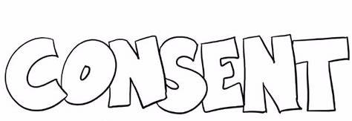










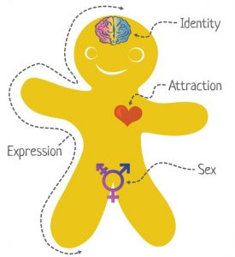






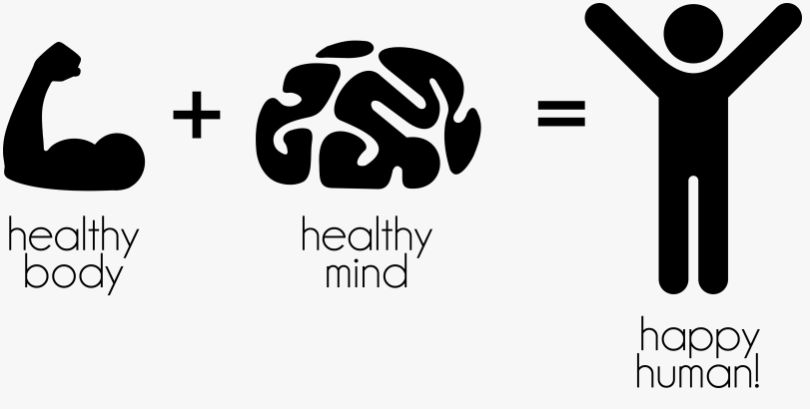
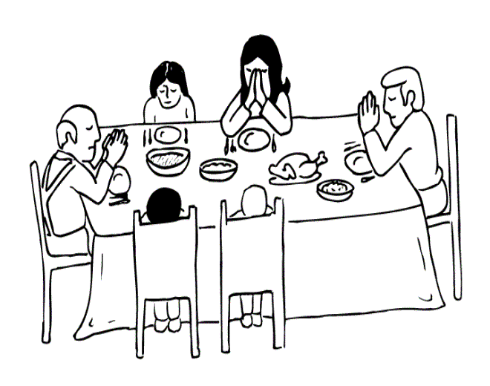





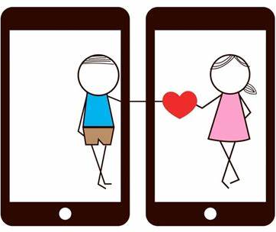



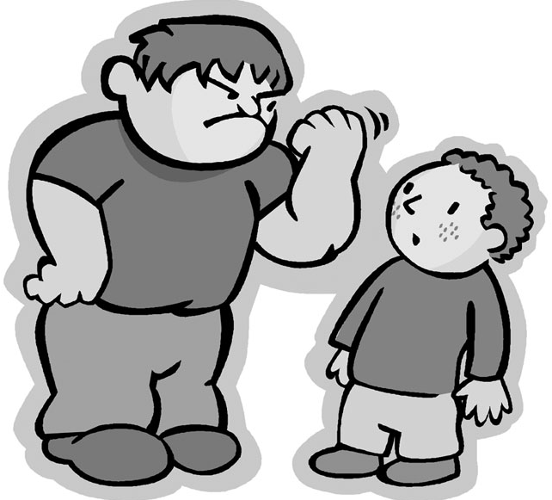




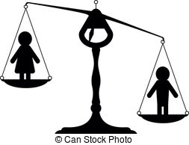











RSE
Learning Journey
Year 7
Understanding and Applying Relationships and Sex Education
Year 11
Self awareness
Healthy friendships
The Law
Sexual health
Consent
Intimate
relationships
Self esteem
Healthy and respectful relationships
Different family types
Being safe
Whole school
Mental health day
Impact of porn on self worth and self esteem
Domestic violence and coercive control
Drugs and risky behaviour
Whole school safer internet day
Whole school anti-bullying week
How can pornography damage a relationship?
Asking for consent in a sexual relationship
Different types of Sexual relationships
Withdrawing consent at any time
Marriage and the law
11
YEAR
HEALTHY RELATIONSHIPS
WELLBEING
Post – 16
Destination
Whole school Anti-Bullying Week
Different types of ceremonies and unions
violence against women and girls
Support available for the family
Impact of family breakdown
Divorce & remarriage
Sharing youth produced imagery and peer pressure
Digital footprint.
Whole school safer internet day
LGBTQ+ and religious attitudes
LGBTQ+ and the law in the UK
Staying safe online – the internet and mental health
Whole school
Mental health day
Family planning
Sexually transmitted infections
AIDS and HIV
Gender equality
History of pride and LGBTQ+ in the UK
WELLBEING
Understanding gender identity and gender expression
Dependency and addiction to technology – does this impact relationships and welling?
SEXUAL HEALTH
GENDER AND LGBTQ+
Body image in a digital world. How can I protect myself from what I see online?
Contraception and reliability
Drink, drugs and behaviour
Promiscuity, casual sex and emotional health
The role of men and women in the family
What is it like to be trans?
Tackling homophobia, transphobia and biphobia. How to be an ally
Protected characteristics – Equality Act 2010
Whole school Anti-Bullying Week
Whole school safer internet day
YEAR
What is sexual harassment?
Forced marriage
Honour based abuse
Consent
Importance of gender equality at home
10
RELATIONSHIPS AND FAMILY LIFE IN THE 21ST CENTURY
Managing and expressing emotions
Emotional health checks
Sexual harassment online
Sexual harassment online
Harassment and stalking
Safe online relationships
WELLBEING
Mental Health Drop Down Day
How Jews manage grief in the family
Purpose of family life in Judaism
Child sexual exploitation
Why is consent always important?
Dealing with the end of a relationship
Sexual harassment and victim blaming
Peer on peer sexual abuse
Discrimination and refugee week
Child criminal exploitation
YEAR
JUDAISM
RELATIONSHIPS
9
Protected characteristics – Equality Act 2010
Sanctity of life – abortion and the law
Purpose of marriage in Judaism
Gangs and unhealthy friendships
Hate crimes
Maintaining healthy relationships
Risks of online relationships
Recognising a toxic relationship
Racism
Impact of LGBTQ+ phobia
Honour-based violence
DISCRIMINATION
Whole school anti-bullying week
Bullying and mental health
E-safety Drop Down Day
Whole school safer internet day
The age of consent and the law
Teenage pregnancy
Consent and online. How can my behaviour online impact others?
Being anti-racist
Religious Discrimination
YEAR
Sharing youth produced imagery
Gender Discrimination
Emotional changes during puberty
8
WELLBEING
RELATIONSHIPS
Physical changes during puberty
Bullying and Mental Health
Impact of prejudice and discrimination on wellbeing
Managing and expressing emotions
Has the internet impacted the way we make relationships with others? How can we form safe relationships online?
Gender
Stereotyping
Managing changing relationships during puberty
Managing peer pressure
What does a healthy relationship look like?
Disability Discrimination
PUBERTY
What is consent? Why is it so important?
Managing friendship – recognising toxic friends
Importance of love and unconditional love
Banter and bullying – what is the difference?
Making new friends and managing changes in friendships
FGM
What can I share online?
Gender stereotypes and gender identity
Whole school safer internet day
Dealing with challenges of a new school
Managing relationships online
YEAR
RELATIONSHIPS
WELLBEING
TRANSITION
7
Romantic relationships and boundaries
Learning to manage emotions
Discrimination and refugee week
Different families
Parenting
What can we do to work for a better community?
Why do we need a community?
What is a Community?
Bullying – where and how to seek help
Whole school anti-bullying week
Transition drop down day
Managing change

