Slide 1

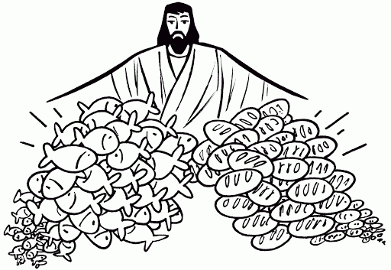

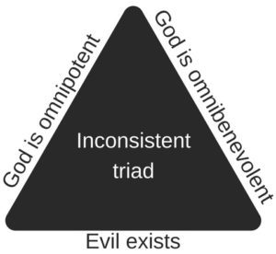


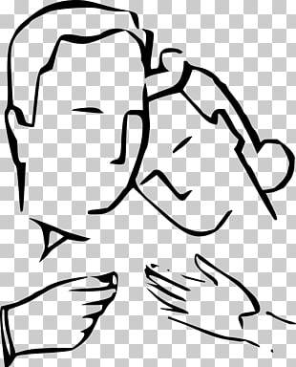









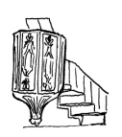






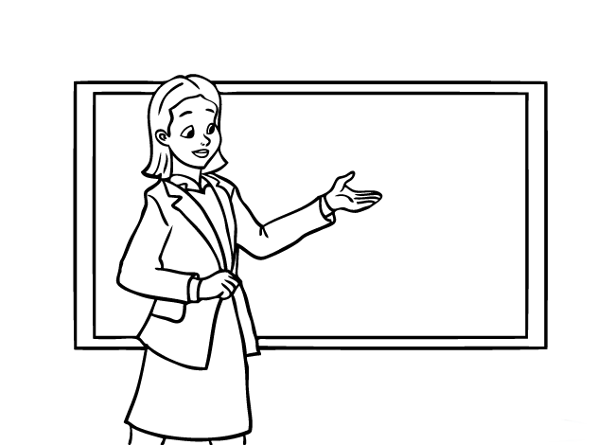





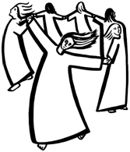

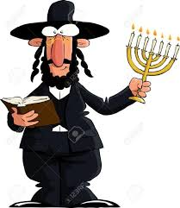

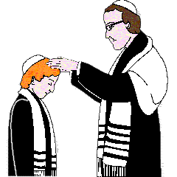


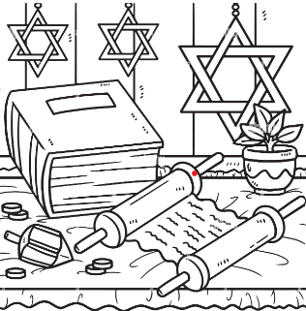

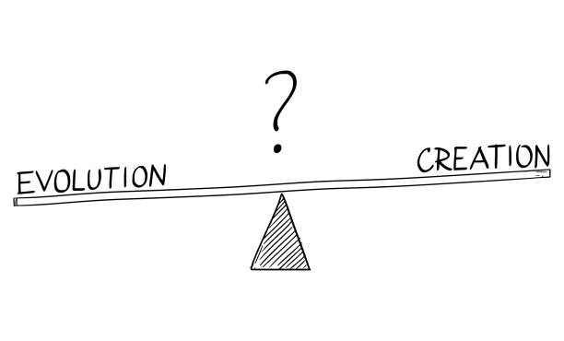





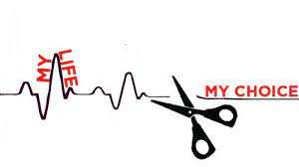
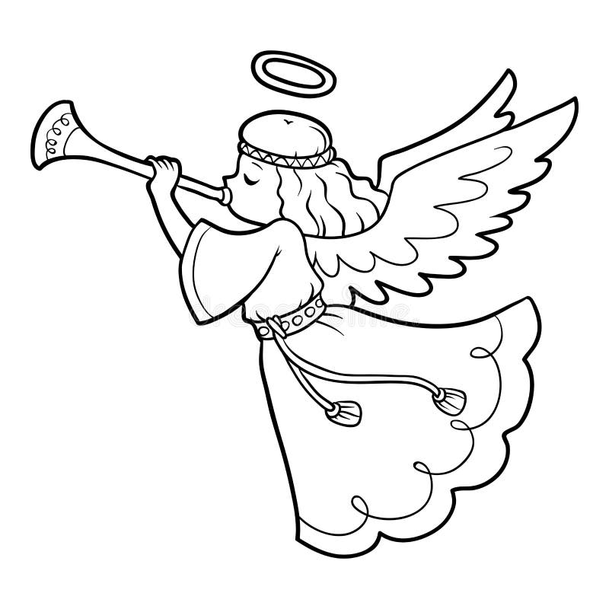


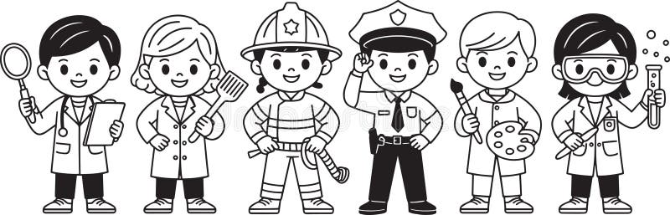

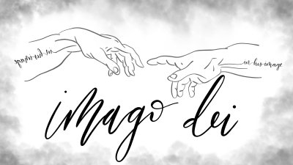
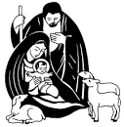

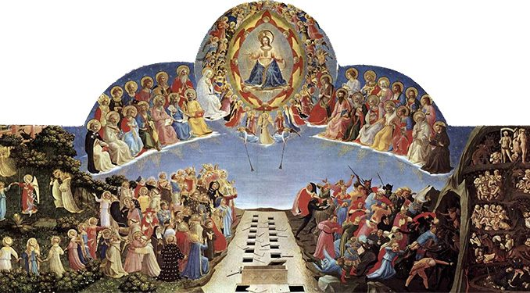


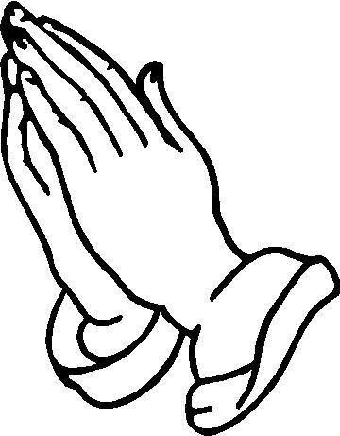


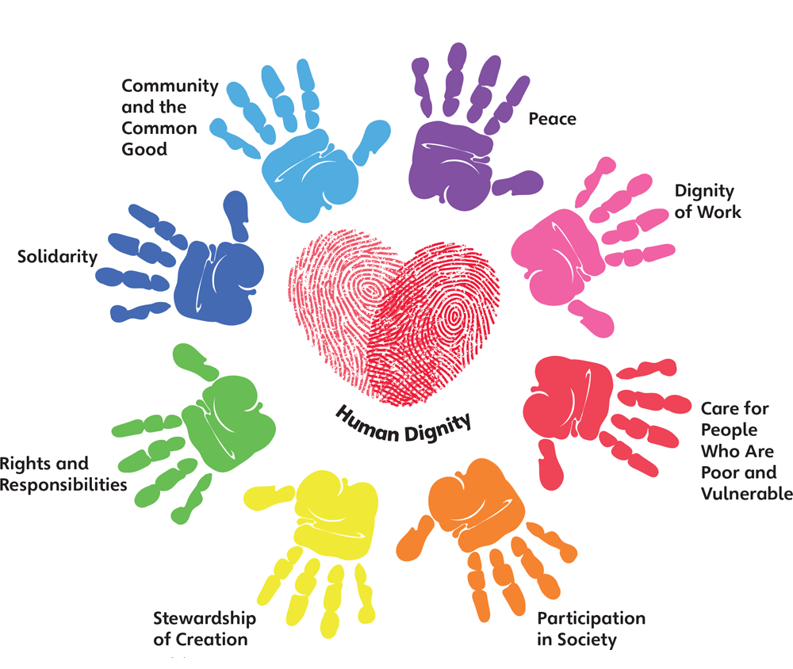
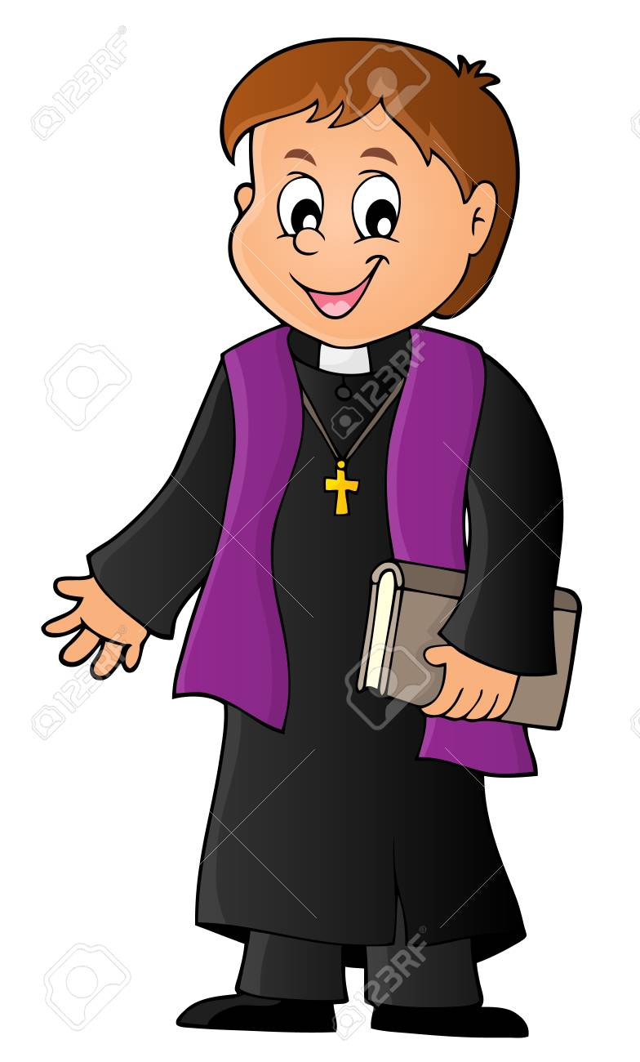

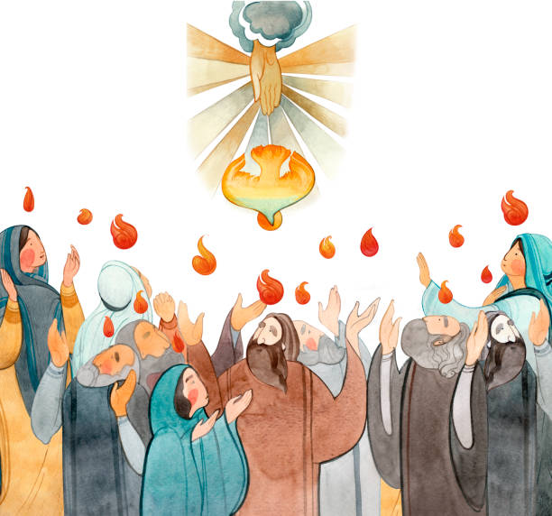
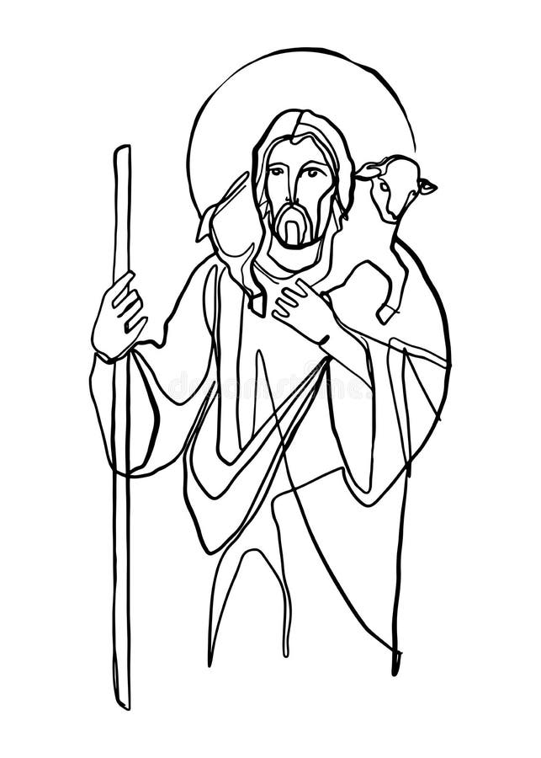

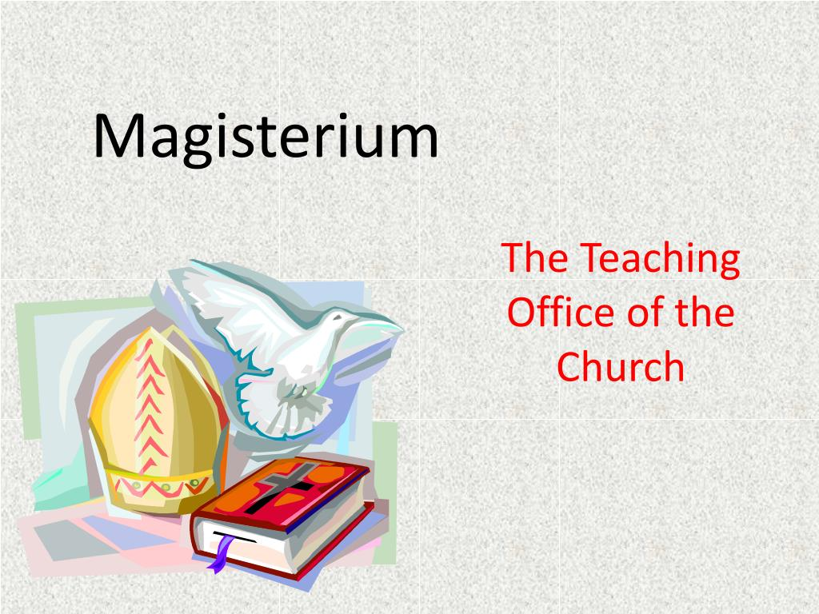


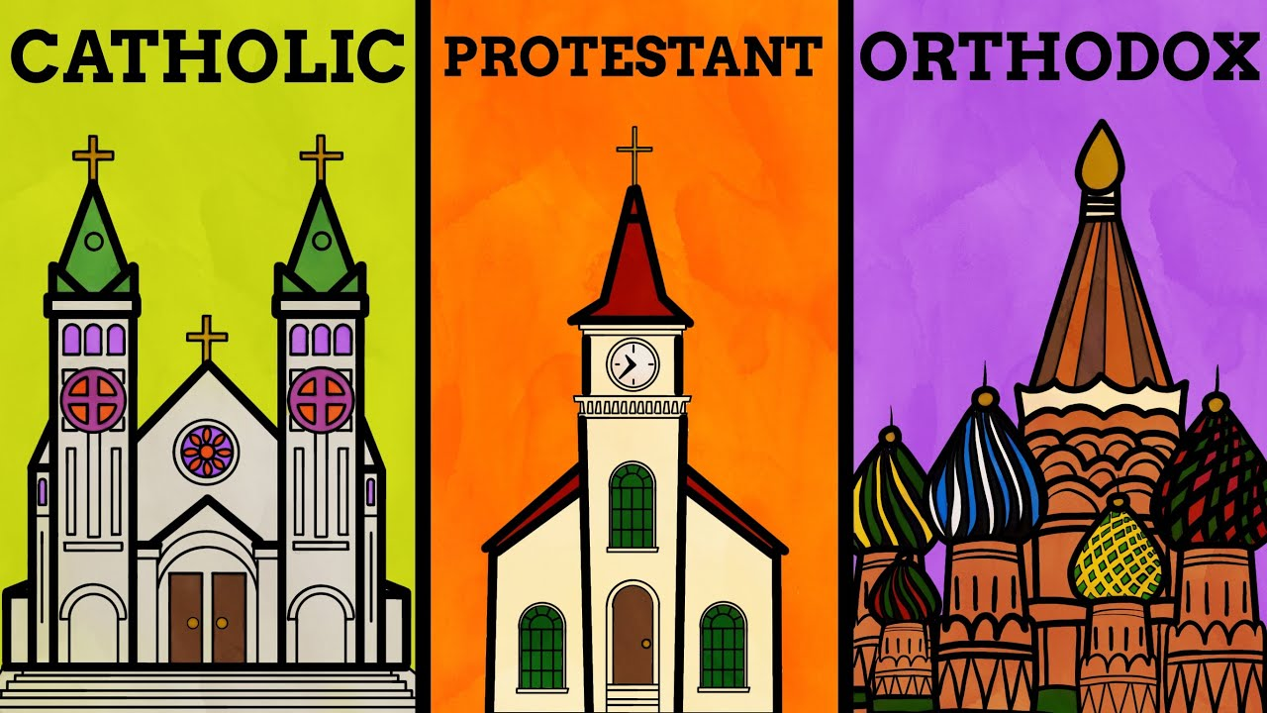
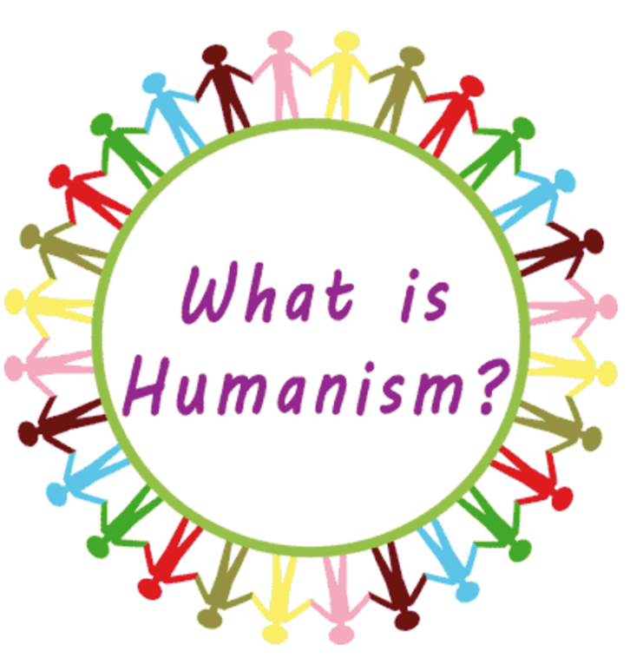






Religious Education
Learning Journey
Year 7
Understanding and Applying Religious
beliefs & teachings
Year 11
Understanding
beliefs
Writing methods
Assessing impact of religious beliefs
Understanding relationships between religion and society
PESAC
Point, Explain, Source, Analysis and Counter/Link
R1 D1, R2, D2
Reason 1 Development 1 Reason 2 Development 2
Retelling
and interpreting stories
Analysis of similarities and differences
Evaluating different viewpoints
The Problem of Evil
Assessing the strength of an argument
Miracles
What are Religious Experiences?
The Design Argument
Theodicy
The role of men and women in the family
PHILOSOPHY & ETHICS
REVISION
Exam & Post – 16
Destination
Family planning
RELATIONSHIPS IN 21ST CENTURY
What is Revelation?
Visions
The Causation Argument
Responses to the Problem of Evil
Gender equality
Gaudium Et Spes
Sexual relationships
The importance of family
The four marks of the Church
Vatican II
Interpreting the Bible
Catholic Social Teaching
YEAR
Supporting family life
11
Applied Catholic Theology
Symbolism
Divorce & remarriage
Marriage
Music
The Magisterium
Life after Death
CAFOD
FOUNDATIONAL CATHOLIC THEOLOGY
Artwork
Privation
The Messiah
Jewish Festivals
Jewish Food Laws
Rituals
The Trinity
Pilgrimage
The Mitzvot
YEAR
The Bible and Interpreation
DIALOGUE AND ENCOUNTER: JUDAISM
10
JUDAISM
Creation
Imago Dei
The Almighty
The Covenants
Jewish Worship
Jewish Holy Books
Sanctity of Life
Science and Creation
The Shekinah
Capital Punishment
The Communion of the Saints
Discipleship
Women in the Old Testament
Protoevangelium
Imago Dei
Attitudes to Abortion
TO THE ENDS OF
THE EARTH
Mark’s Gospel
Typology
The Afterlife
DESERT TO
GARDEN
GALILEE TO
JERUSALEM
PROPHECY AND
PROMISE
CREATION AND COVENANT
Attitudes to Euthanasia
Angels and Saints
The Temple
The Old and New Covenant
The Importance of Mary
St Catherine of Sienna
Purpose and Vows: Catholic
YEAR
Vocation
9
The Religious Life
Holy Orders
Personal Sin
Imago Dei
What do the prophets teach us?
The Kingdom of God
Parables
The Easter Triduum
Life after Death
The Last Things
What are the 5 pillars?
What is the problem of Islamophobia?
What makes
us human? The Fall
Advent
The Sacrament of Reconciliation
DIALOGUE & ENCOUNTER: Islam
CREATION AND COVENANT
PROPHECY AND
PROMISE
GALILEE TO
JERUSALEM
DESERT TO
GARDEN
TO THE ENDS OF
THE EARTH
How is Jihad misunderstood?
YEAR
John the Baptist
How do Muslims worship?
8
Baptism
Being Witnesses to Christ
The Sacrament of the Sick
The Problem of Evil and Suffering
The Resurrection
Miracles
Fasting, Almsgiving and Prayer
What happens when we die?
Different Christian Denominations
The Holy Spirit and Pentecost
The Sacraments
The Paschal Mystery
The Incarnation
Scripture and
the Mass
The Magisterium
The Role of Prayer
Genesis Creation Stories and God
Humanism
DIALOGUE AND ENCOUNTER
Who is Jesus?
YEAR
TO THE ENDS OF
THE EARTH
DESERT TO
GARDEN
GALILEE TO
JERUSALEM
PROPHECY AND
PROMISE
CREATION AND
COVENANT
7
Atheism and Agnosticism
Confirmation
The Trinity
Living with the Spirit
Different Eucharistic Beliefs
The Eucharist
Living as Jesus Taught
How is Scripture Inspired?
The Bible
Science and Creation
Human Responsibility

