Slide 1


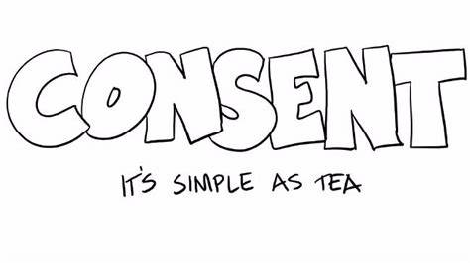












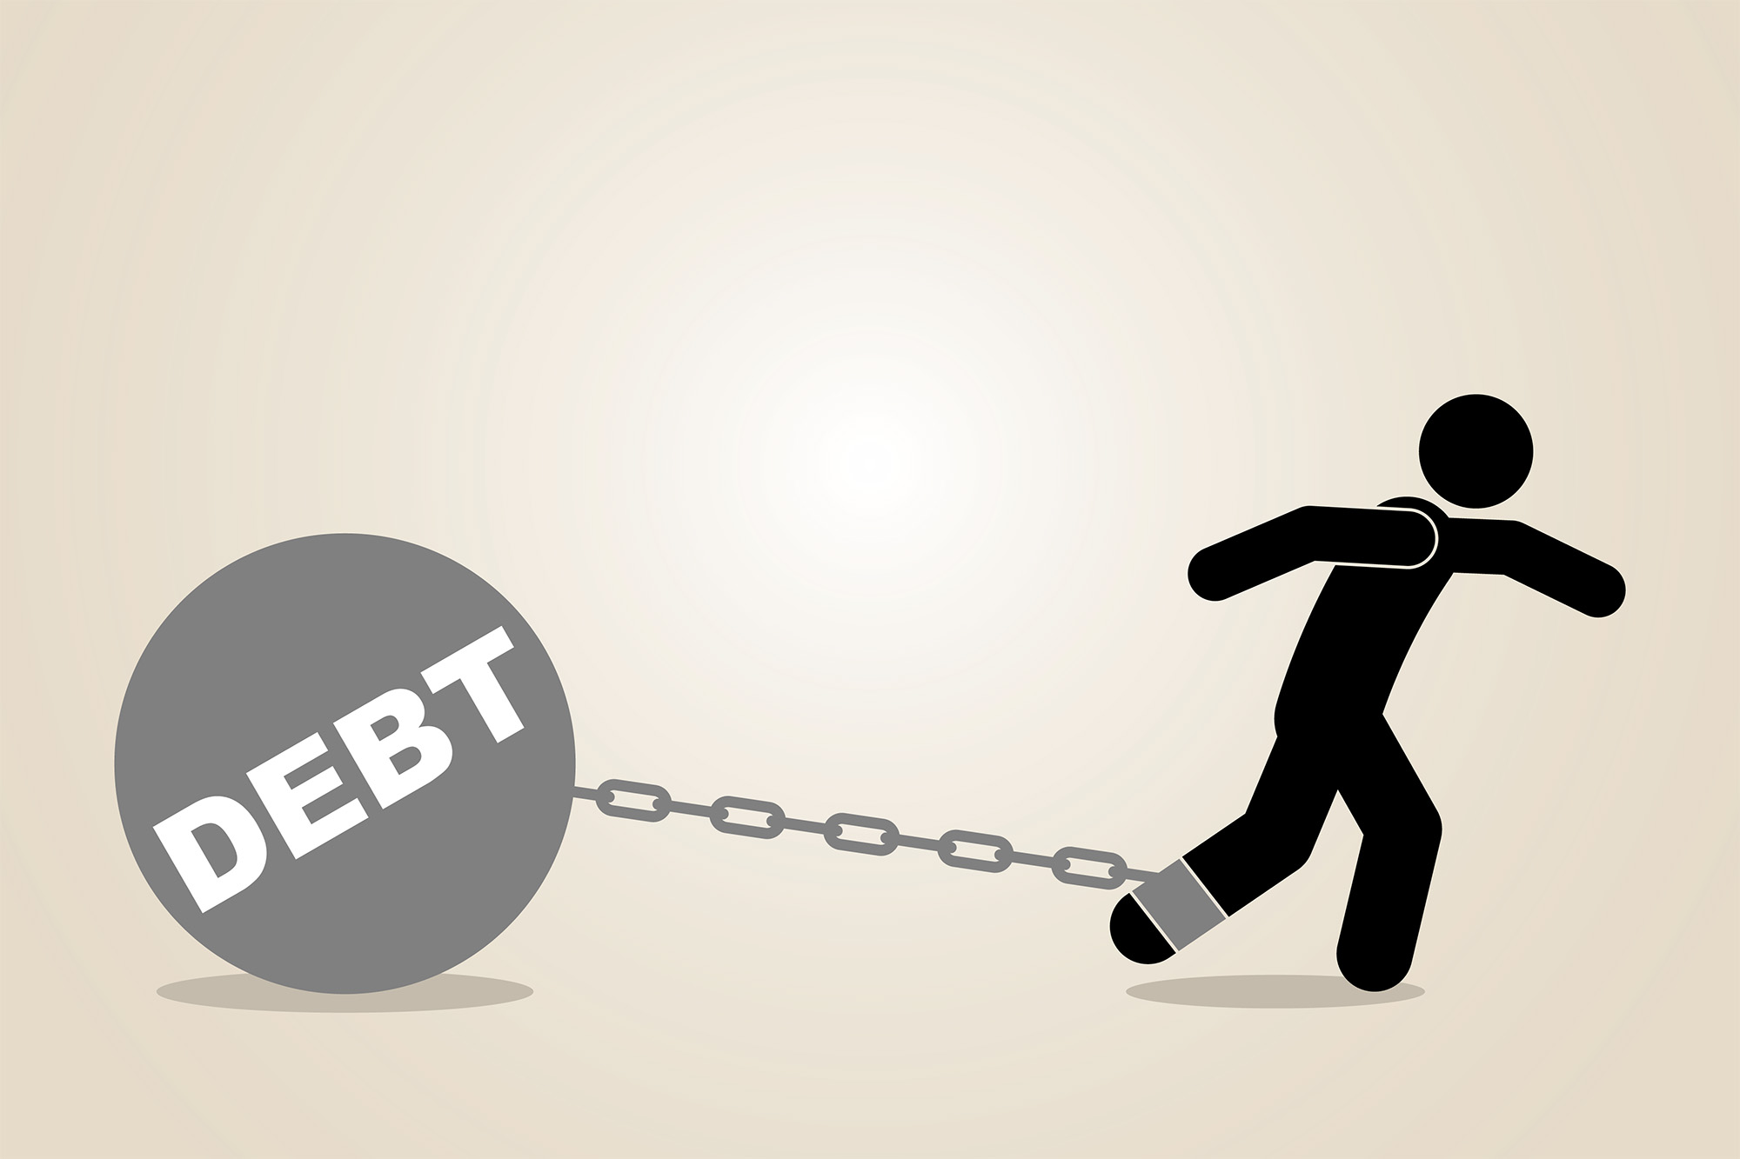

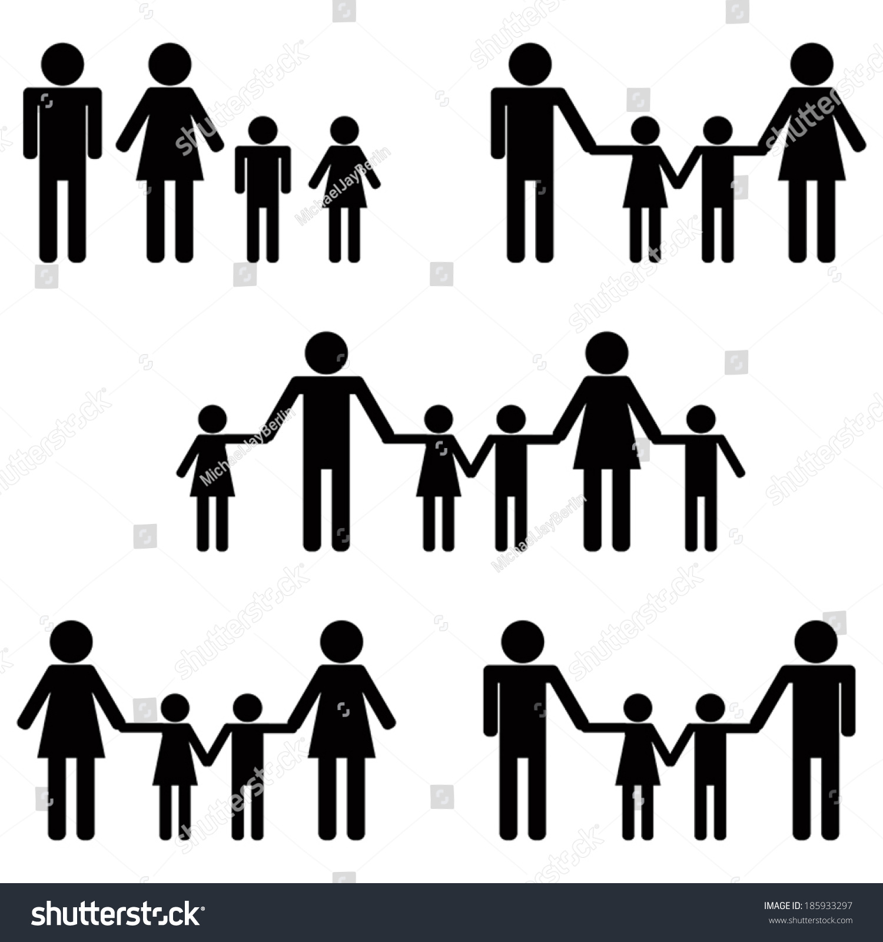






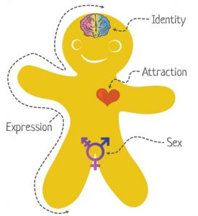

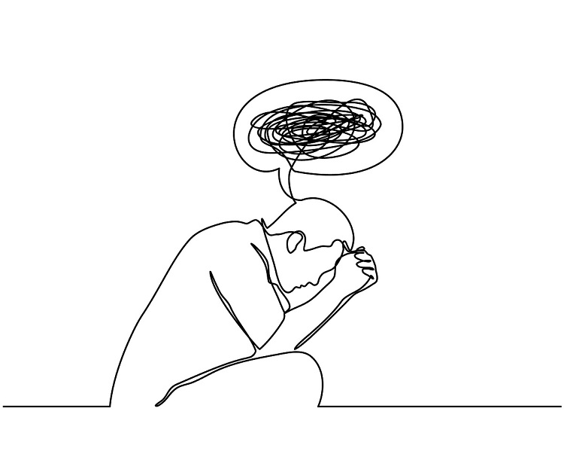









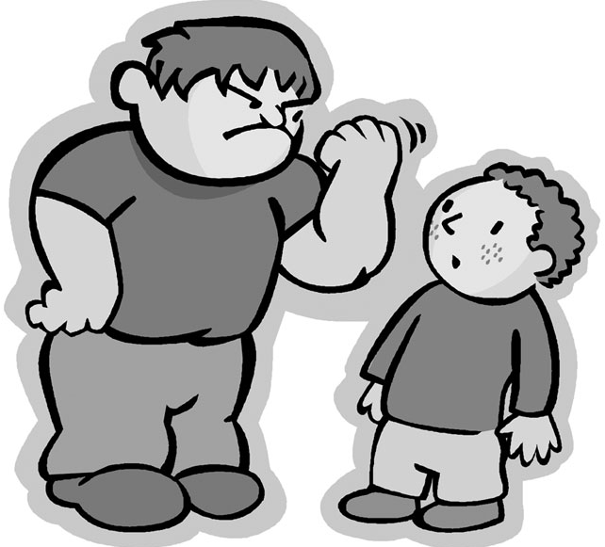

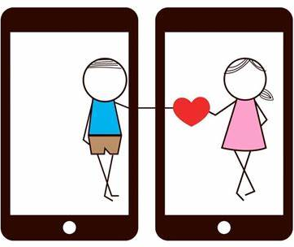





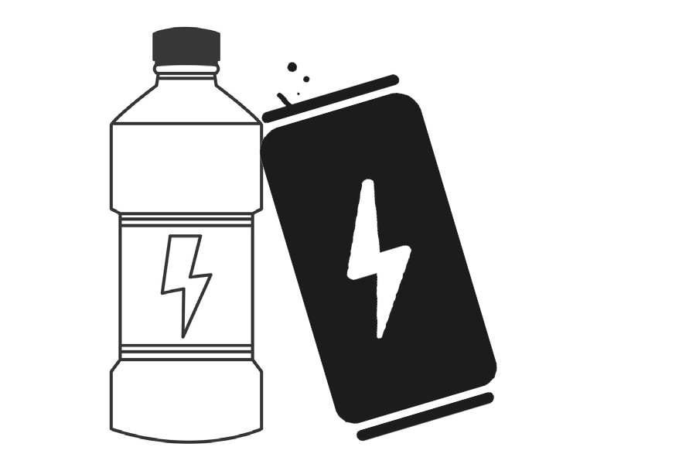


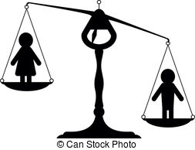




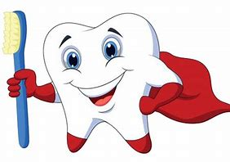




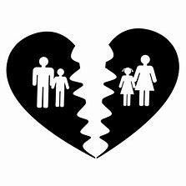


Religious Education
Learning Journey
Year 7
Understanding and Applying PSHCE
Year 11
Self awareness
Healthy friendships
The Law
Sexual health
Diversity
Citizenship
Financial education
Self esteem
Healthy relationships
Big questions
Being safe
British values
Sharing youth produced imagery and peer pressure
Asking for consent in a sexual relationship
Different types of Sexual relationships
Part time jobs
Rights in the work place
Local labour market
Life after Barlow – post 16 options
Whole school anti-bullying week
Cosmetic and aesthetic treatments
Emotional health checks
Impact of porn on self worth and self esteem
Support available for the family
Withdrawing consent at any time
Changing attitudes towards sexual relationships
Domestic violence and coercive control
RELATIONSHIPS
LIVING IN THE
WIDER WORLD
HEALTH AND
WELLBEING
Post – 16
Destinations
Harassment and stalking
violence against women and girls
The role of men and women in the family
Different types of families
Marriage
Digital footprint. Why is this so important?
Whole school safer internet day
Whole school
Mental health day
Coping with exam stress
Body image
Importance of gender equality at home
How can pornography damage a relationship?
Divorce & remarriage
Impact of family breakdown
Family planning
STI’s
AIDS and HIV
Depression and anxiety
Mental illness – signs and treatment
Voting. Why bother?
What happens in an election?
Refugees and asylum seekers
Personal statements and CVs
Different types of ceremonies and unions
YEAR
YEAR
Debt and payday loans
Marriage and the law
11
LIVING IN THE WIDER WORLD
The importance of family
HEALTH AND WELLBEING
Apprenticeships
Contraception and reliability
Response in an emergency
Overcoming addiction
Drink, drugs and behaviour
Promiscuity, casual sex and emotional health
Gambling and addiction
Role of the government
British values – discrimination and tolerance
Drugs and the law
Drugs – nitrous oxide
Future me day
Protected characteristics – equality act 2010
Work experience preparation
Whole school anti-bullying week
Body image in a digital world
What is sexual harassment?
Gender equality
Forced marriage
Honour based abuse
Pornography
LGBTQ+ and the law in the UK
YEAR
YEAR
Managing and expressing emotions
10
RELATIONSHIPS
History of pride and LGBTQ+ in the UK
Men and mental health
Online sexual harassment
Tackling LGBTphobia. How to be an ally
What is it like to be trans?
Understanding gender identity and gender expression
HEALTH AND WELLBEING
Drugs and health
Careers and option choices
Taking financial risks
Child criminal exploitation
Why is consent always important?
Dealing with the end of a relationship
Sexual harassment and victim blaming
Peer on peer sexual abuse
Managing anxiety
Getting arrested
Youth court
Child sexual exploitation
Personal finance
Toxic masculinity
YEAR
County lines
LIVING IN THE WIDER WORLD
YEAR
Personal finance day
RELATIONSHIPS
9
Protected characteristics – equality act 2010
Debt
Women in STEM
Hate crimes
Maintaining healthy relationships
Risks of online relationships
Recognising a toxic relationship
Impact of LGBTQ+ phobia
Human rights
Deep fakes media reliability
Violence against women and girls
Racism
Basic banking
Apprenticeships
Racism
Fake news and media reliability
LIING IN THE WIDER WORLD
Whole school anti-bullying week
honour-based violence
The age of consent and the law
How can my behaviour online impact others?
Being anti-racist
E-safety drop
down day
Bullying and mental health
Whole school safer internet day
Peer pressure and body image
Teenage pregnancy
Knife crime and the law
Drug laws
YEAR
Coping strategies
Sharing youth produced imagery
religious discrimination
Wellbeing in the work place
YEAR
8
International women's day
8
HEALTH AND WELLBEING
RELATIONSHIPS
Gender discrimination
Being a responsible digital citizen
Drugs and dependency
Smoking and vaping
Impact of prejudice and discrimination on wellbeing
Energy drinks
Managing and expressing emotions
How can we form safe relationships online?
Banter and bulling
Sexuality and coming out
What does a healthy relationship look like?
Disability discrimination
Gender
stereotyping
How are laws made?
Protecting my data online
Hate crime
LIING IN THE WIDER WORLD
Managing friendship – recognising toxic friends
Banter and bullying
First aid and emergency response
Emotional and physical changes during puberty
Dealing with challenges of a new school
Managing relationships online
Online scams and data protection
Teamwork and workplace skills
What is consent? Why is it so important?
What can I share online?
Gender stereotypes and gender identity
Parenting
Whole school safer internet day
FGM
What are British values?
Oral health
YEAR
Responsible citizen drop Down day
RELATIONSHIPS
HEALTH AND WELLBEING
7
Romantic relationships and boundaries
Discrimination and refugee week
Divorce and separation
Different families
Why do we need a community?
Community cohesion
Bullying – where and how to seek help
Learning to manage emotions
Sleep
Whole school anti-bullying week
Transition day
Managing changing relationships during puberty
Managing change

