Slide 1

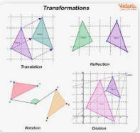
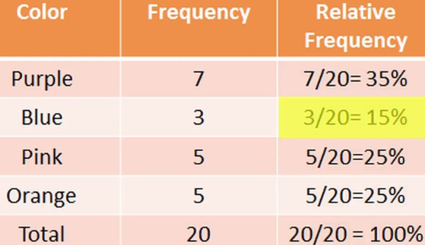
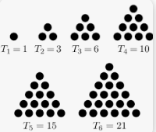
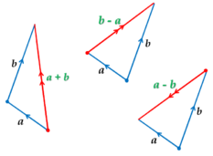

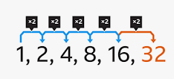
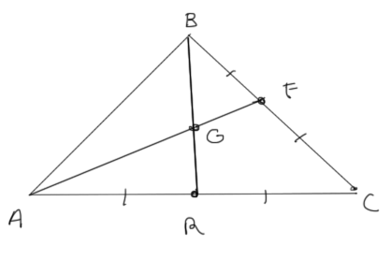
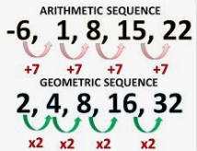
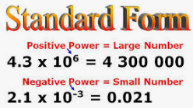
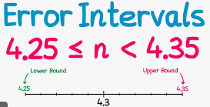
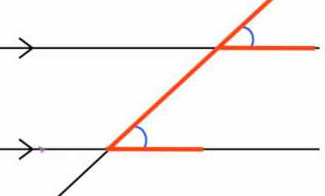



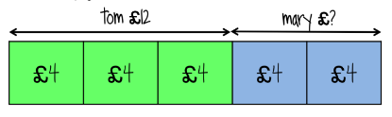
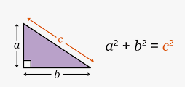
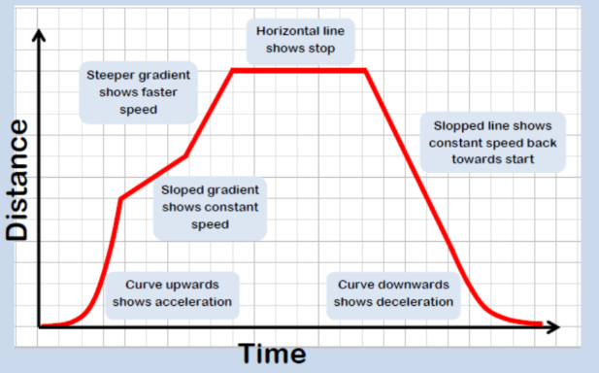
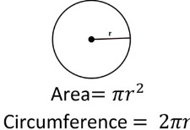
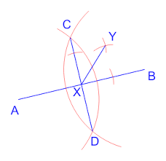

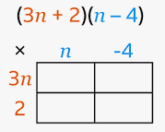
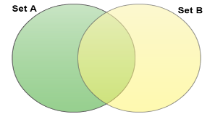

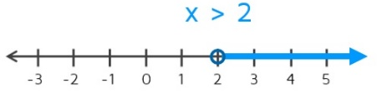
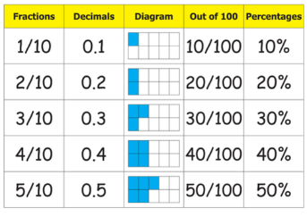
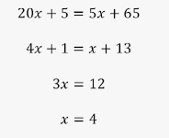
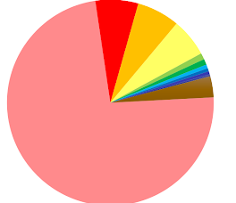
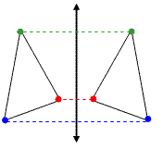
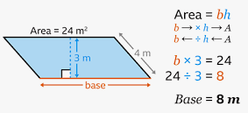
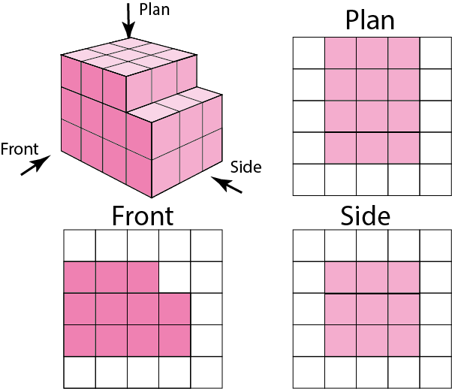
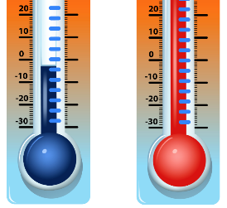
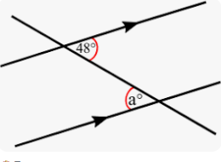
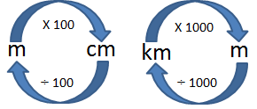

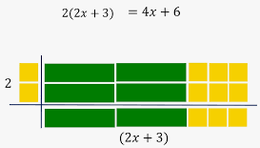
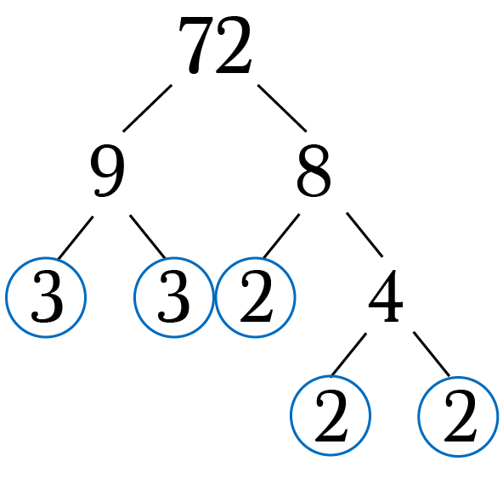
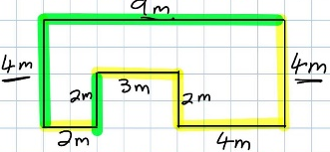

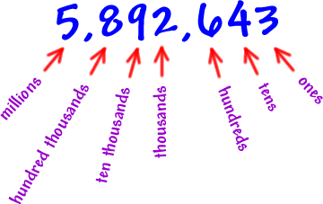

Mathematics
Foundation Tier Learning Journey
2025-26
(Y11 following existing scheme)
Year 7
Working Mathematically
Develop fluency - Reason Mathematically - Solve problems
Year 11
Become fluent in the fundamentals of mathematics
Solve problems with increasing sophistication
Extend and formalise knowledge
Extend fluency
Use mathematical language precisely
Reason deductively
Solve multi-step problems
Begin to follow lines of enquiry
Identifying and interpreting gradients
Relative Frequency
Venn diagrams
Find position to term rule
Recognising special sequences
Column vectors
Mensuration review
PROBAILITY
SEQUENCES, GRAPHS, FUNCTIONS & GRAPHS
TRANSFORMATIONS & SIMILAR FIGURES
VECTORS
Exam & Post – 16
Destination
GEOMETRIC REVIEW
Sample space diagrams
Generate linear and geometric sequences
Vector arithmetic
Angles review
Distance between two points using pythagoras’ theorem
Interpreting y=mx+c
Translations, reflections, rotations and enlargements
Problems involving surface area, volume, nets and elevations
Plans and Elevations
Expanding double brackets
Position to term
Cubic
Averages from a table
Index numbers
Finding error intervals
Combining transformations
Direct proportion
Sampling
Acceleration
2D & 3D
REPRESENTATIONS
Negative indices
Bias
Velocity graphs
Maps and scale drawings
HANDLING DATA & STATISTICAL DIAGRAMS
BRACKETS
INDICES
ERROR INTERVALS
TRANSFORMATIONS
PROPORTION
HANDLING
DATA
SEQUENCES
GRAPHS
Reciprocal
YEAR
Changing
ratios
11
Frequency polygons
Factorising quadratic expressions
Error intervals for truncated numbers
Inverse proportion
Combining ratios
RATIO
Calculating with pressure
Positive indices
Geometric sequences
YEAR
Calculating with density
COMPOUND MEASURES
10
Volume of prisms
Algebraically
Exact values
Independent events
TREE
DIAGRAMS
Vectors
Angles of elevation and depression
Constructing loci
Plotting real life graphs
Using venn diagrams
Dependent events
Data project:
Collect
Represent
Analyse
Interpret
PERCENTAGES
SURFACE AREA
& VOLUME
SIMULTANEOUS
EQUATIONS
FORMULAE
TRIGONOMETRY
CONSTRUCTIONS
& LOCI
LINEAR
GRAPHS
SET NOTATION
HANDLING DATA, VECTORS
Graphically
Using probability with venn diagrams
Using set notation
Transforming shapes problems
Compound Interest
Growth and decay
Surface area of polyhedra
Changing the subject
Using bearings
Equations of parallel lines
Similarity problems
TRANSFORMATIONS, SIMILARITY & CONGRUENCY
Rearranging expressions
Length of arcs, volume of cylinders
Theoretical and experimental probability
Problem solving with Standard Form
Equations of lines from graphs
Proportion word problems
Linear inequalities
Identifying bearings
QUADRATIC GRAPHS, ANGLES & BEARINGS
LINEAR GRAPHS, COMPOUND MEASURES AND MOTION-TIME GRAPHS
RATIO & PROPORTION
ROUNDING,
3D SHAPES & PYTHAGORAS’
THEOREM
FORMULAE, CONSTRUCTIONS & CIRCLES
INEQUALITIES & QUADRATIC EQUATIONS
PROBABILITY, STANDARD FORM
Percentage change
Plotting and interpreting Quadratic graphs
FRACTIONS & PERCENTAGES
Problem solving with fractions & percentages
Triangles and
Pythagoras
Angles in polygons
Speed and rates problems
Speed, Distance, Time graphs
Constructing bisectors
Solving Quadratic equations
YEAR
9
YEAR
Fractional Increase and decrease
Significant figures
Coordinates and midpoints
BRACKETS, ALGEBRAIC FRACTIONS & RECURRING DECIMALS
Recurring decimals
8
Problem solving
Theoretical Probability
Index laws
Sequence rules
Introduction to Standard Form
Surface Area of prisms
Plotting graphs
STATISTICAL
DIAGRAMS & INEQUALITIES
Calculating with fractions
PROPORTION INVOLVING FRACTIONS, DECIMALS & PERCENAGES
PROBABILITY
PERCENTAGES & MONEY
INDICES, EQUATIONS SEQUENCES &
RATIO
ROUNDING, COORDINATES, AREAS & CIRCLES
STANDARD FORM, VENN DIAGRAMS, 3D SHAPES
SURFACE AREA & VOLUME
LINEAR GRAPHS, TRANSFORMATIONS & ANGLES
Translations
Averages and range
HANDLING DATA & STATISTICAL
DIAGRAMS
Reverse fractions of amount
Percentage change
Calculating with money
Areas of parallelograms and trapeziums
Constructing nets
Volume of prisms
Enlargements
Rotations
Reflections
Identifying & estimating
Calculating angles
Solving Equations with variables on both sides
Names of lines
ANGLES
Add, subtract fractions
Finding prime numbers
Shape properties
Converting units of length
Substitution
Inequality symbols
Rounding
BRACKETS
YEAR
Expanding and factorising with single brackets
FRACTIONS
FACTORS,
MULTIPLES & PRIMES
PERIMETER, AREA & COORDINATES
2D SHAPES
MEASURES
EXPRESSIONS &
EQUATIONS
NUMBER SENSE AND CALCULATIONS
7
Comparing fractions
Identifying HCF, LCM
Perimeter and area of rectangles & triangles
Line properties
Estimating
Ordering fractions
Forming expressions
Solving Equations
Ordering integers and decimals
Labelling place value
Multiplying and dividing negative numbers

