Slide 1

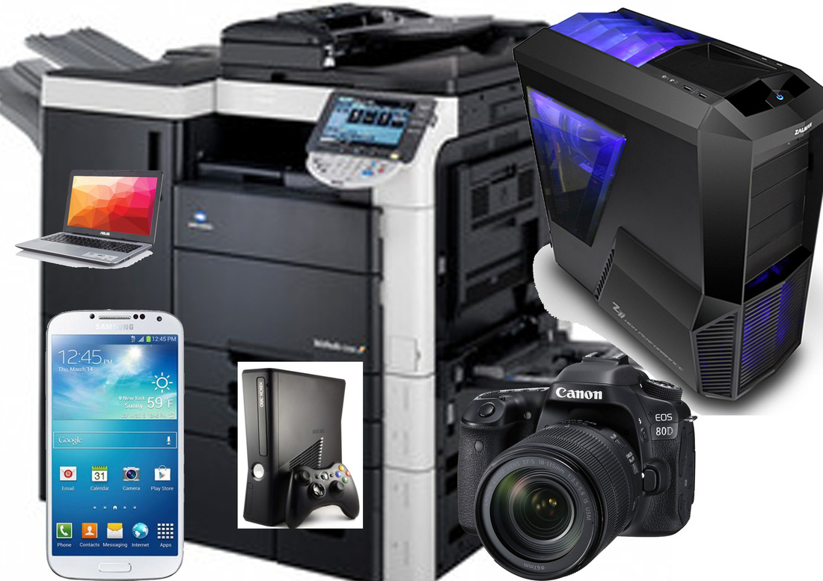
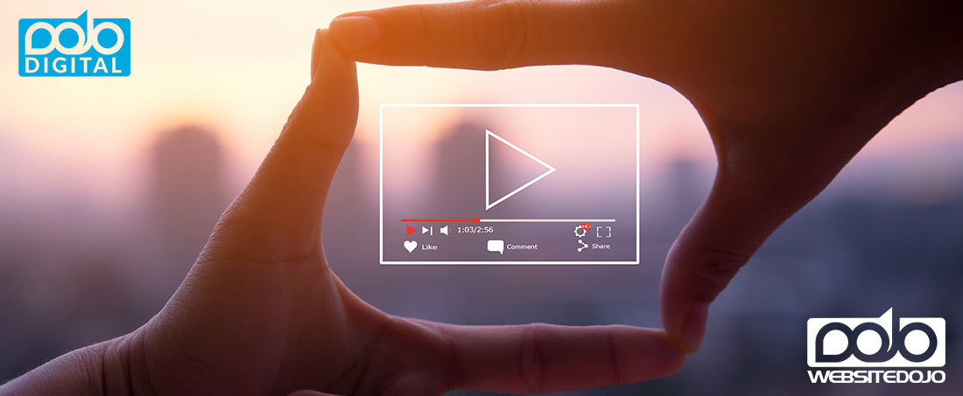

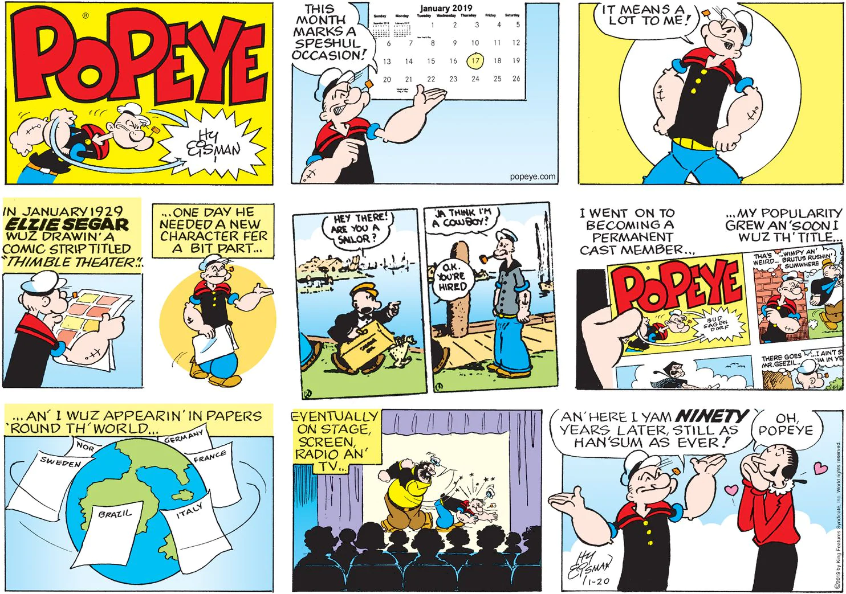
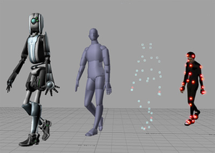
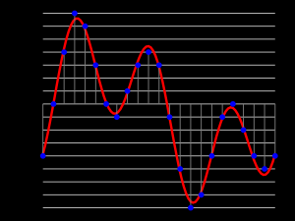

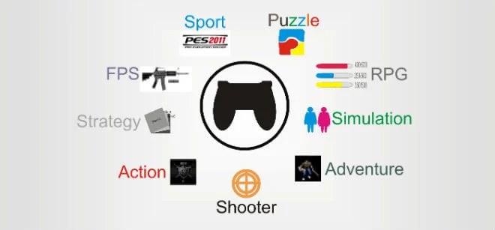
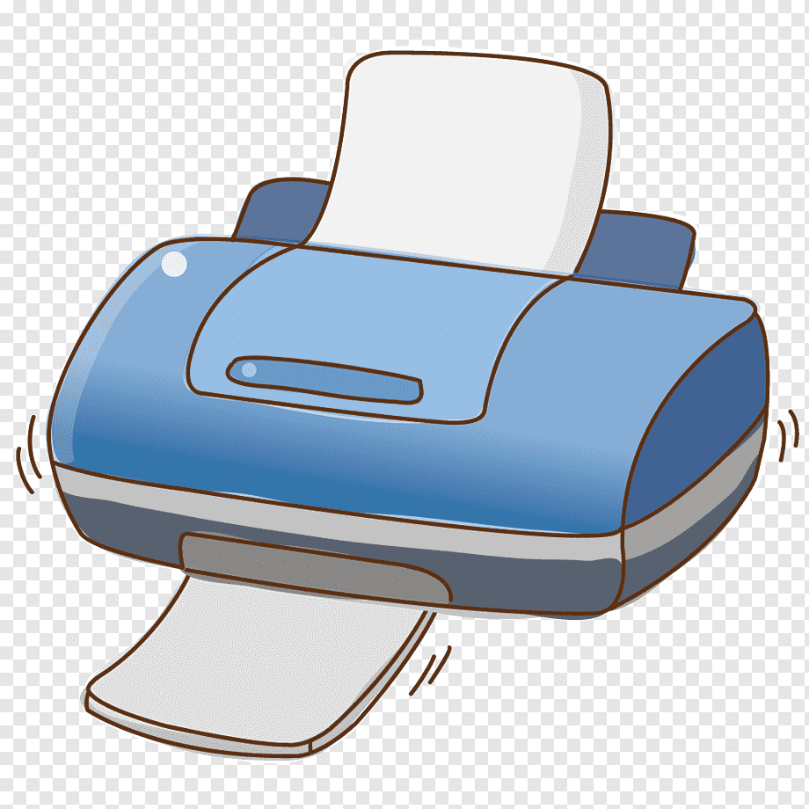

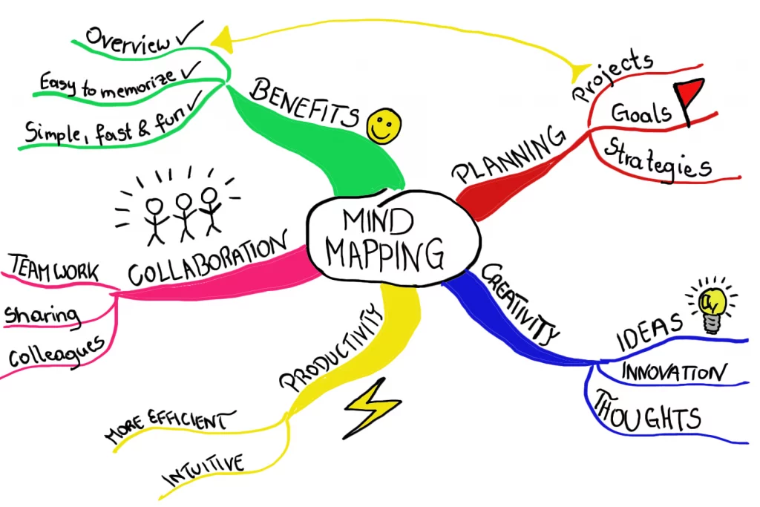


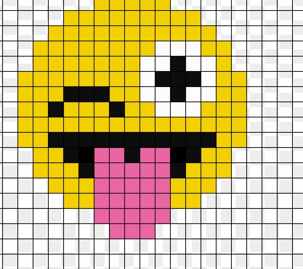

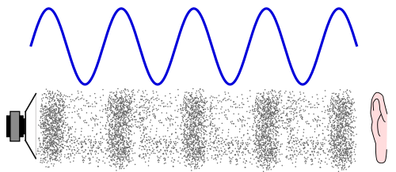




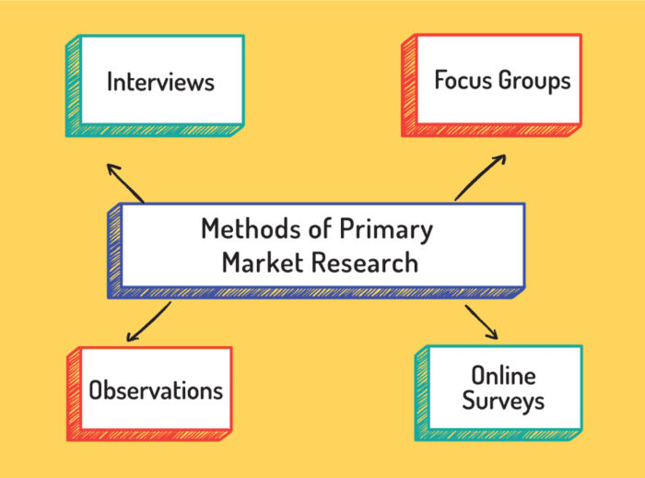



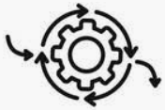








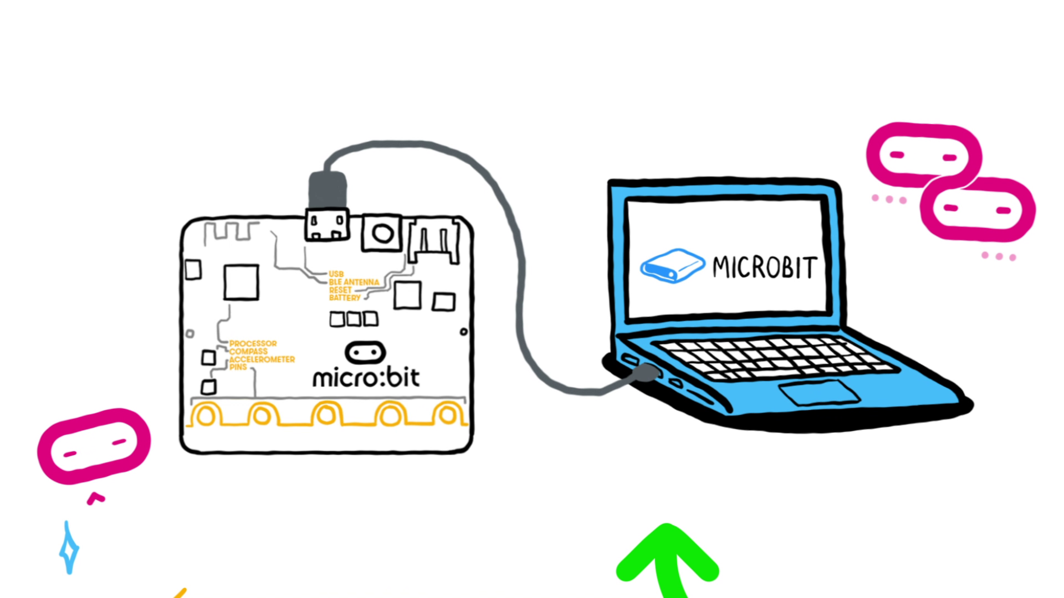
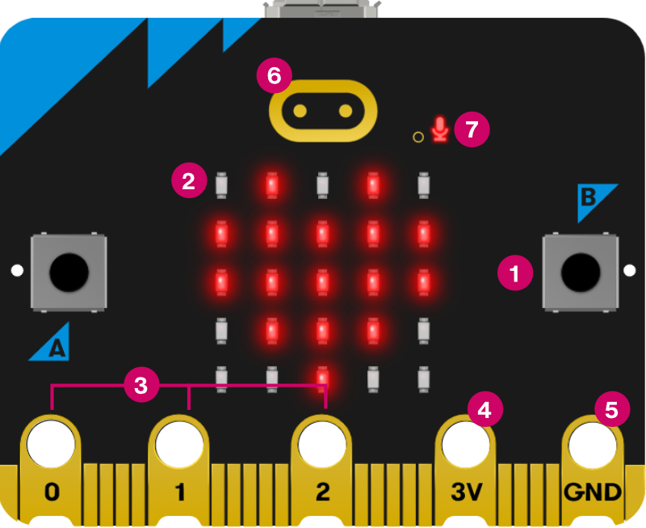

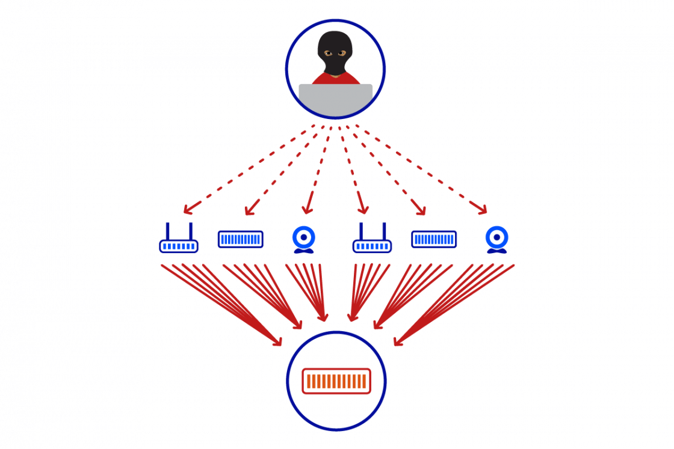
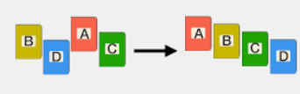


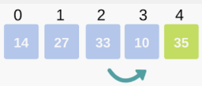
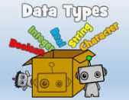
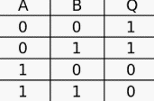











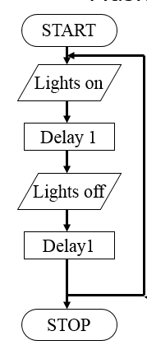

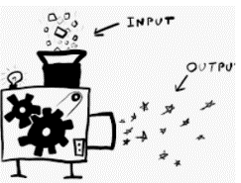
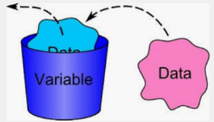




iMedia
Learning Journey
Year 7
Understanding and Applying iMedia Skills
Year 11
Getting started / use of the network/ file management
How computers work
Web design
Photo editing
E-Safety
Networks
Ethics
R094 – Develop Visual Identity
Optional unit
R093 – Creative iMedia in a media industry
Characters and comics
research
Media codes
Mood boards
Cameras and lighting
Review Completed Artefact
R093 – Creative iMedia in a Media Industry
Exam & Post – 16
Destination
Create Artefact
Job roles
Storyboards
Mind maps
Sectors
Purpose/style/content/layout
Animation
Optional unit
Plan for Creating Artefact
Digital games
Areas of improvement
Version control
Interactive digital media
YEAR
Review from a brief
Exporting for print and web use
Contingencies
Understand use of digital media unit
11
R094 – Creating visual identity
Identify resources
Visual imaging
Identify assets
Saving the digital graphic in an appropriate format
Using a range of tools
Sourcing and creating assets
Work plan
Develop visual identity
Audience and purpose
Visualisation diagram
Visualisation diagrams
Final products in line
With client requirements?
How are they used?
Types of digital graphics?
Pixel dimensions
Target audience
YEAR
Tiff/JPG/PDF
YEAR
10
Mind map
10
R094 – Develop Visual Identity
Client requirements
Data representation sound/image
Design and layout
Permissions
Sampling rates
Legislation
Licences
File types and formats
Options for start up and small businesses
Sequence
Computational thinking
Logos
Society
Ethics
Purpose of Utility programs
Photoshop
Layers
Use Iteration
Profit/Loss
Cash Flow
Malware
Privacy issues
Ethics
Photo Editing
Microbit programming
Business
plans
Social engineering
Sustainability
What’s the difference between a for and while loop?
How do you solve problems?
Boolean operators
Cyber Security
Graphics
Selection IF/ELSE
Bots
Filters
Layers
DDOS
YEAR
YEAR
User input
9
Searching data
What’s Linear search?
sequence
Iteration
CPU
Memory
Training models
Bias
Boolean logic
Cells
YEAR
Web Design
8
Searching/Sorting algorithms
Textual programming
Systems architecture
AI and
Digital footprint
Logic
Web design
Navigation
Charts/Graphs
Sorting data
What’s bubble sort?
Name 4 data types?
Input/process/output
Embedded systems
Decision trees
Digital graphics
Master page
Data Modelling
Selection
What’s a Truth table?
How to draw a logic Diagram
formula
How computers work
What’s hardware and software?
What is binary?
Visual programming
Algorithm thinking
Cyberbullying
GDPR
open/close/edit/save files
school network
Abstraction
YEAR
Binary representation
Block Programming
Computational thinking
E-safety
Getting started
7
What’s an output?
What’s an input?
Character set
Denary
What is a variable?
What is a flowchart?
Pattern recognition
What is personal data?
Define malicious programs
What’s a secure password?
Use range of applications.
ASCII
Decomposition

