Slide 1



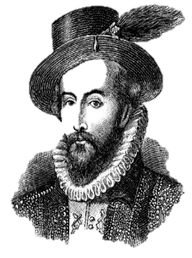


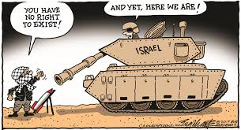
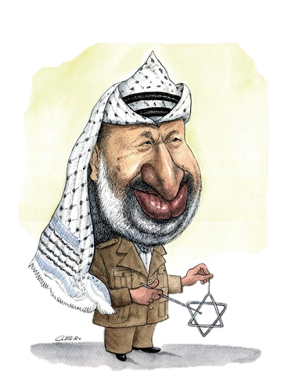

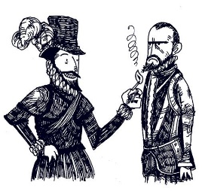

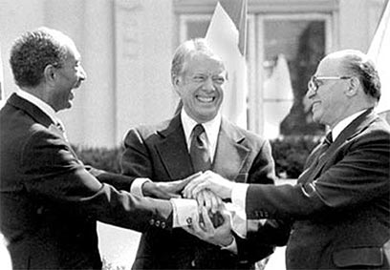




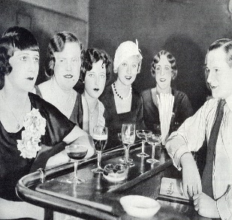

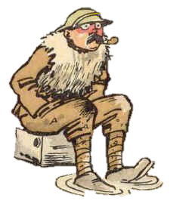
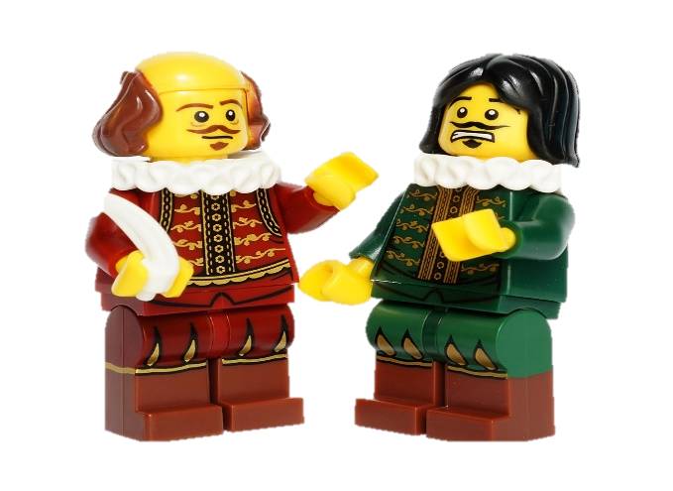


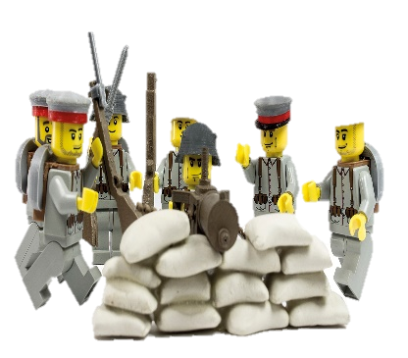
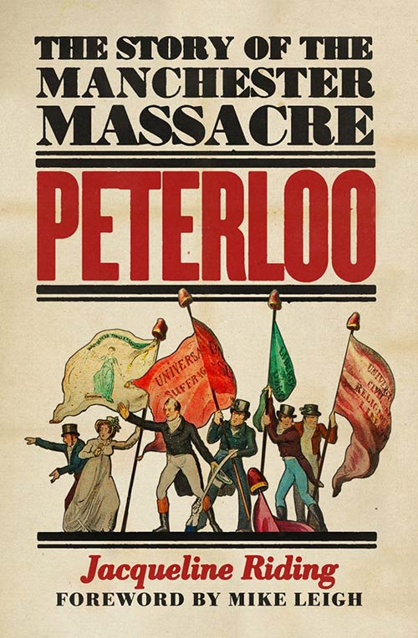


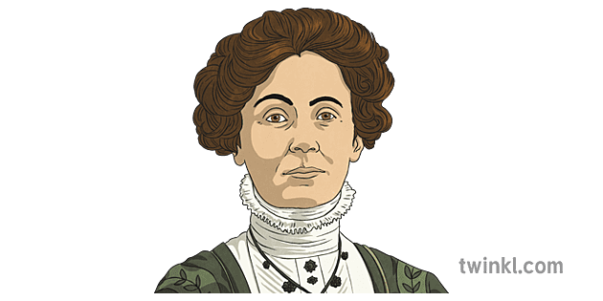









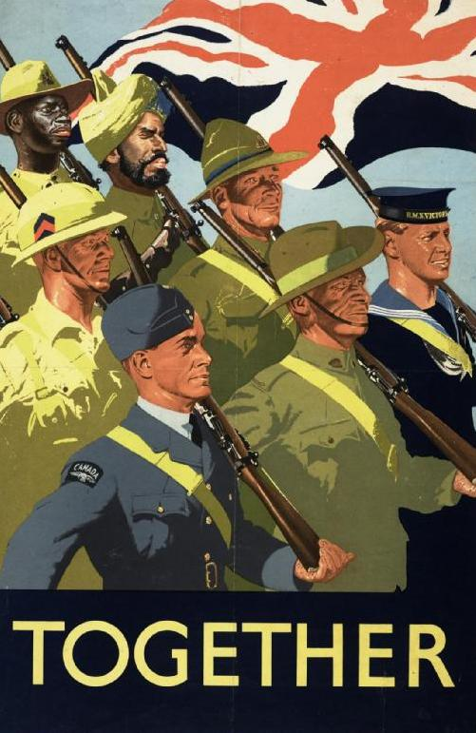



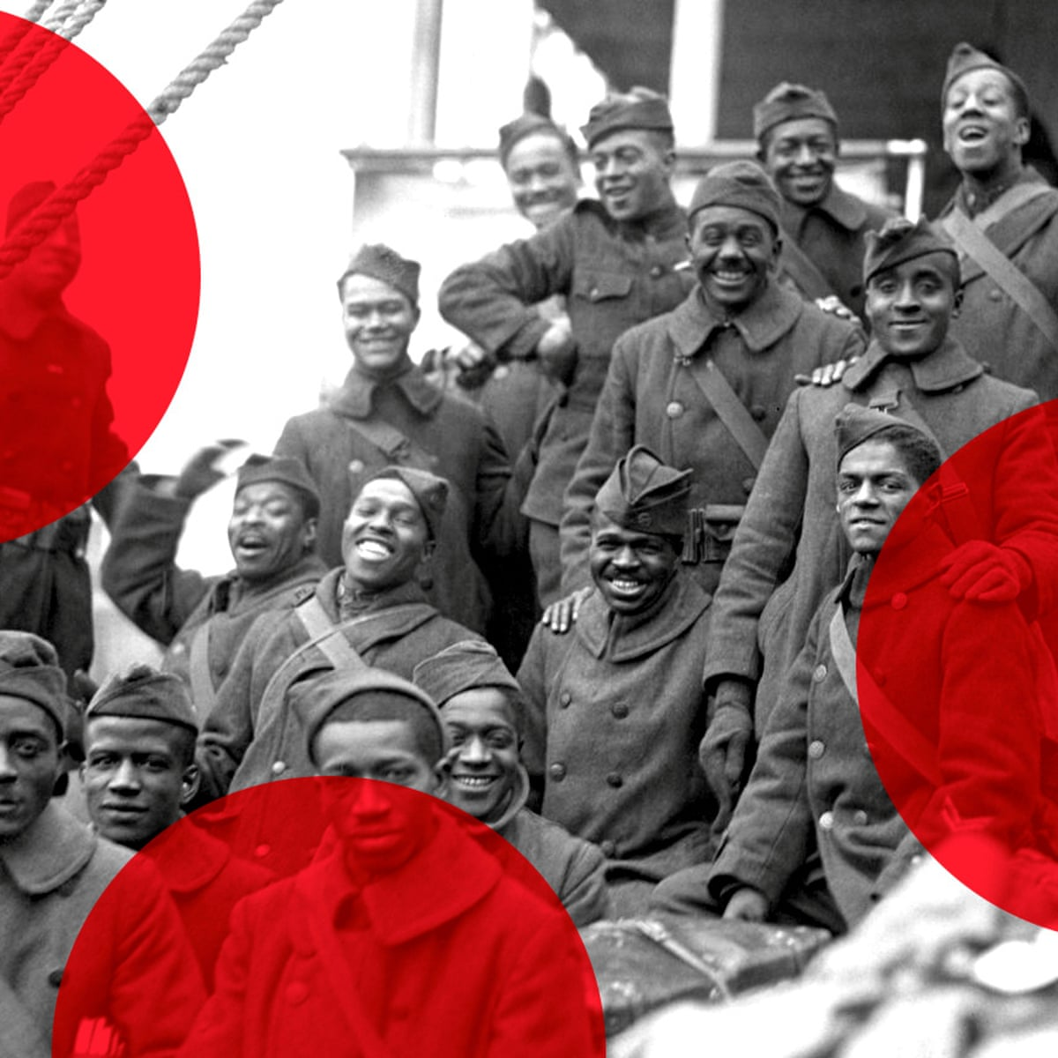




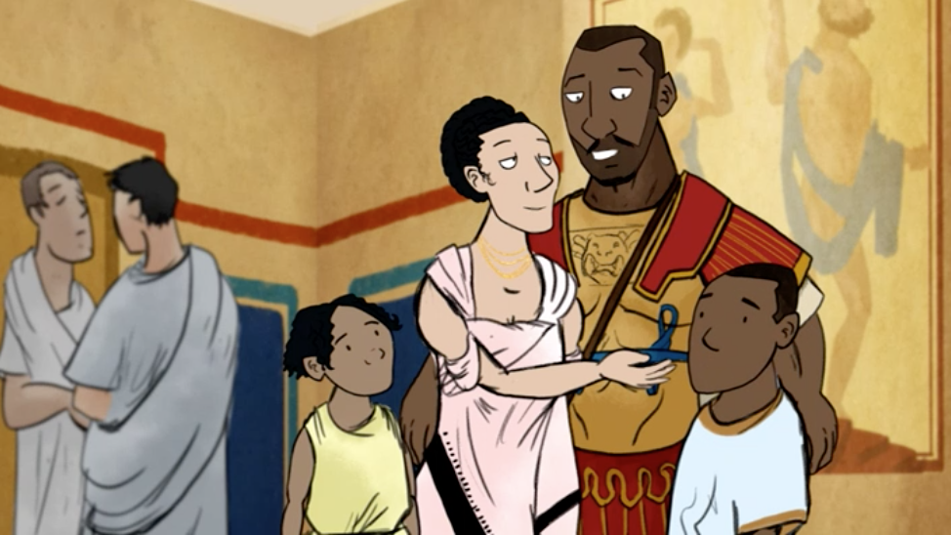
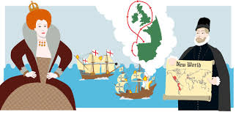
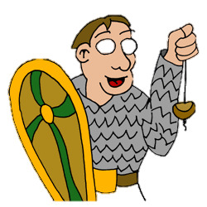
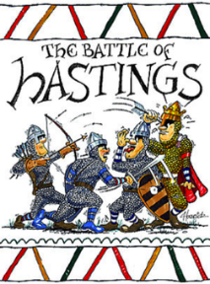

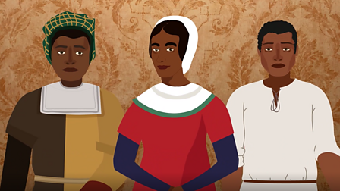


History
Learning Journey
Year 7
Understanding and Applying Historical Skills
Year 11
Describing key features
Explaining causes and consequences
Developing narrative accounts
Making inferences from historical sources
Developing enquiries from historical sources
Analysing and evaluating interpretations of the past
Explaining changes over time
Explaining the importance of events
Analysing and evaluating hypothesese
Judging the usefulness of historical sources
Identifying and explaining how and why interpretations of the past differ
Early Elizabethan England, 1558-88
Conflict in the Middle East
1945-95
Exam & Post-16
Destination
Year
11
Weimar and Nazi Germany, 1919-39
The British sector of the Western Front, 1914-18: injuries, treatment and the trenches
Year
Why is Manchester such an important city in the British Isles?
10
Medicine in Britain,
c.1250-present
How and why did British society become so diverse?
Why was the Holocaust able to happen?
Year
9
Year
In what ways did industrialisation change Britain?
Was the ‘Great War’ really that great?
Why was World War II truly a world war?
8
What was the Norman Conquest and how did it shape the British Isles between 1066 and 1485?
Who were the Romans and in what ways did they change the British Isles?
Year
Who were the Tudor monarchs
and what was it like to experience life in Tudor England?
7

