Slide 1



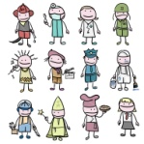



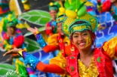


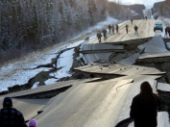




























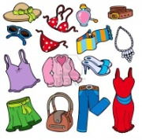




















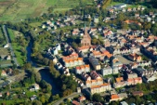


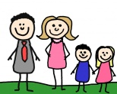

French
Learning Journey
Year 7
Understanding and Applying Language Skills
Year 11
Establishing pronunciation skills
Understanding key grammatical concepts
Applying grammatical knowledge – tense formation
Exploring tenses further
Exploiting reading skills including working out unfamiliar messages
Writing a coherent and fluent response
Developing speaking and listening skills
Expanding reading and writing skills
Widening vocabulary
Dealing with unfamiliar language
Giving an authentic response that includes accent and tone
Discussing marriage and partnership using conditional and future tenses
Considering global issues
Discussing ethical shopping
Talking about local actions
Talking about family relationships
Customs and festivals
MA FAMILLE ET MES AMIS
UN OEIL SUR LE MONDE
Exam & Post – 16
Destination
Revising sport, music,
films and TV
LE TEMPS LIBRE
Describing friendships
Talking about the environment
Talking about natural disasters
Future and past plans
Giving opinions about school subjects
YEAR
Describing famous celebrity events
Talking about your school
Maintaining a healthy lifestyle
Talking about holiday disasters
Buying souvenirs
11
Discussing career choices
Keeping fit
LES PROBLÈMES SOCIAUX
MON COLLÈGE
& BON TRAVAIL!
LA MODE DE VIE
Looking at celebrity culture
Discussing technology use
Describing your daily life
Discussing school rules
Body parts and injuries
Describing family celebrations
Ordering in a restaurant
Talking about an ideal holiday
LES VACANCES
Visiting a tourist attraction
Discussing plans and the weather
Booking and reviewing hotels
Using reflexive verbs
Describing your house
Describing a region
Giving directions
Discussing what to see and do
YEAR
Talking about food
Describing what happened on holiday
10
EN VILLE
EN VACANCES!
Talking about your town/village
Describing your ideal town (conditional tense)
Using three tenses together to write about your town
Talking about travelling
Imagining adventure holidays
Using the conditional tense
Practising using the future tense
Talking about sport
Using modal verbs
Using the imperfect tense
Practising using 3 tenses together
Making plans to get fit
Using three tenses together
Describing a date
Arranging to go out
Discussing holidays
Giving your opinion about someone
Discussing your future and your past
LE MONDE DU TRAVAIL
UNE VIE SAINE
Talking about Facebook
MA VIE SOCIALE
Saying what you need to do
Learning languages
Describing jobs
Using il faut +infinitive
Talking about healthy eating
Learning parts of the body
Talking about how you celebrate your birthday
Saying what films you like
YEAR
Talking about TV programmes
Understanding info about a tourist attraction
Talking about clothes
9
Saying what films and books you like
Talking about relationships
Talking about personality
YEAR
Using three tenses
together
Describing what you can do in town
8
MES PASSETEMPS
& À PARIS!
MON IDENTITÉ
CHEZ MOI,
CHEZ TOI
Describing a trip to Paris
Describing your home
Talking about meals
Saying where you go in town
Using the past tense
Talking about music
Using the near future tense
Talking about your passion
Describing where you live
MA ZONE
Describing what other people do
Talking about food
Describing your timetable
Using present tense –er verbs
Saying when your birthday is
Talking about your pets
Giving directions
Talking about which sports you play
YEAR
MES PASSETEMPS
MON COLLÈGE
MA VIE
7
Talking about your town/village
Saying what you like doing
Talking about computers and mobiles
Giving opinions and justifications
Talking about school subjects
Talking about age, brothers and sisters
Talking about your family
Introducing yourself

