Slide 1



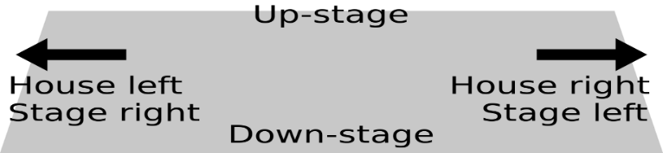
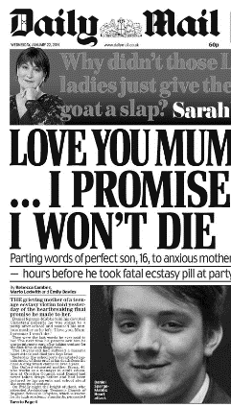



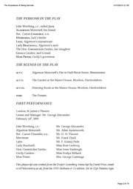

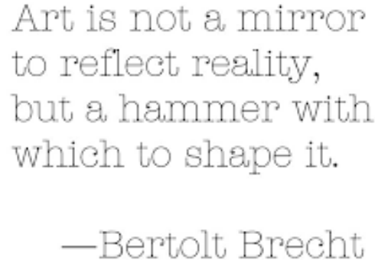

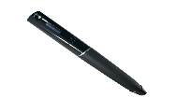
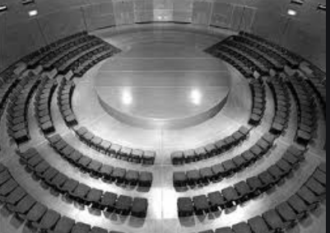
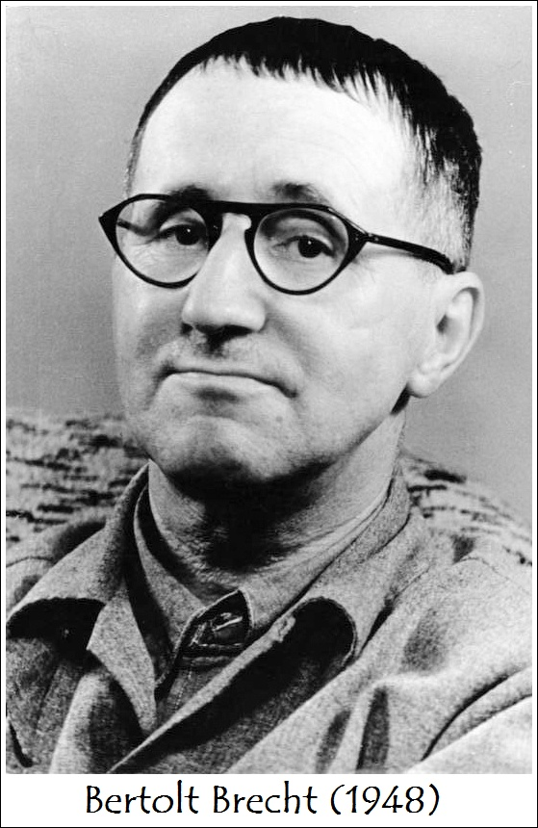

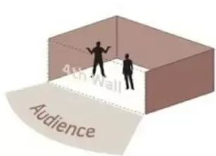


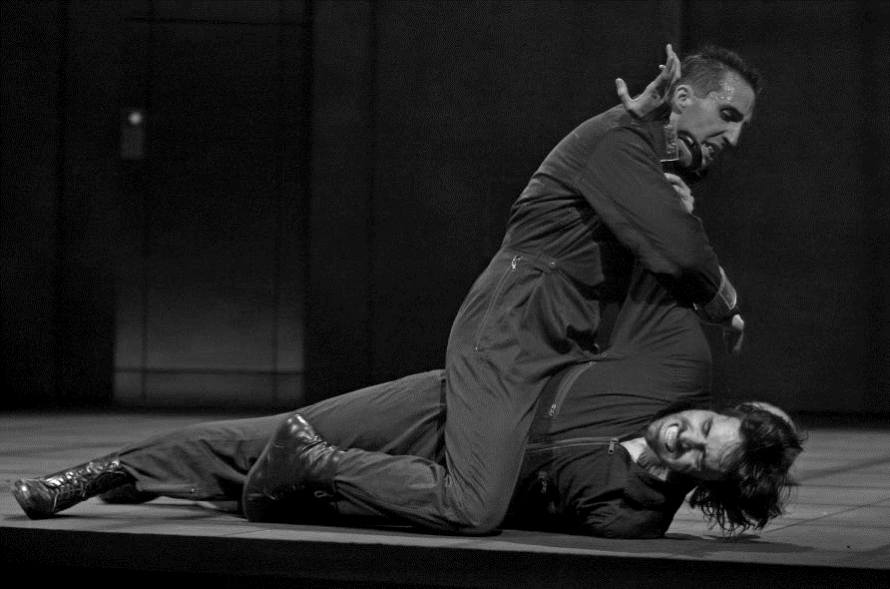

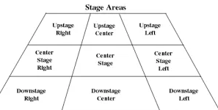
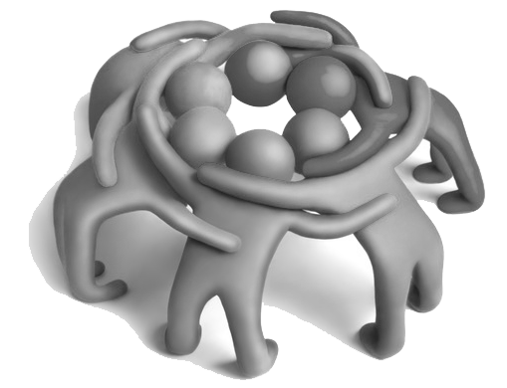



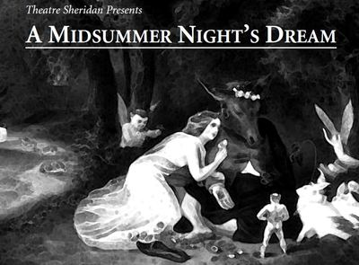


Drama
KS4 Learning Journey
Year 7
Understanding and Applying Skills
Year 11
Applying theatrical devices
Devising
Style and Genre
Performing
Using voice and movement
Creating a character
Staging and blocking
Planning and researching from a stimulus
Evaluating theatre
Audience address
Designing theatre
Social and Historical context
-Voice
-Movement
-Interaction with others
-Interaction with audience
Watching live theatre
Evaluating acting skills
Writing a review
Written exam 1.30 hrs
Proxemics
Exam & Post – 16
Destination
Rehearse and refine
C3 Interpreting Theatre
Artistic Intentions
Voice and movement
Playwright’s intentions
Performance spaces
Role of a director
Character relationships
C2 Performing from a Text
Blocking
Learning Lines
Dress rehearsal
Exploring characters and
their personality
Themes – Party drugs
Ensemble
Mark Wheeler
Physical movement
YEAR
Verbatim Theatre
Duologues/ monologues
C3 Interpreting Theatre
11
C3 Interpreting Theatre
Target audience
Status and Power
Social and Historical context
Sound to create atmosphere
Practical Exploration
Style & Genre
Designing a set
Minimalist Costume and set
Explorative Theatre
What makes good theatre?
Incorporating style and practitioner
Abstract drama – using symbolism
Multi-roling
Set and costume
Planning and script writing
Characterisation
YEAR
10
C1 - Devising Theatre
Verfremdungseffekt –
Alienation effect (distancing)
Role-on-the-wall
Exploring Stimuli set by Eduqas
Research into practitioners
Written portfolio of development and contribution
Stage types
Understanding drama
Ensemble/ Choral work
Social issues in school
Black History
Claudette Colvin
The little rock nine
Improvisation –
Physical and Vocal skills
Audience participation
Montage
Epic Theatre
Why does theatre have to educate?
Multi-Rolling
Status
Segregation
Multi-use prop
Do we judge people on the way they look?
Forum theatre
Teechers by John Godber
BHM Exploration
Role models
PSHE and SMSC
Comedic Timing
Prejudice
Narration
Status explored through characters
Over exaggeration
BLM Movement:
George Floyd & Breonna Taylor
YEAR
Breaking the 4th wall – Audience Address
Creating Drama for a purpose
9
Slow Motion
Thought Tracking
Subtext
Breck Bednar
Murdered
YEAR
Exaggeration
Learning lines
Flash backs/ Flash forwards
8
Physical Theatre
Game Over by
Mark Wheeler
Devising Theatre
Moral of the story.
Target audience.
WW2
History - WWII
Ensemble
How safe is online gaming?
Language of role
Students will explore a range of Stimulus’ from different genre’s
Characters
Verbatim Theatre
What is a Stimulus?
Evacuees
Devising/Stimulus
Stage directions
Status and
Proxemics
Roleplay
Exploring Physical and Vocal skills
Developing teamwork
Shaun Tan the arrival – Graphic Novel
Freezeframe
YEAR
A Midsummer Nights Dream
An introduction to Drama
7
Spontaneous
Improvisation
English
Narration
Stage Positions
Monologues/Duologues
Martin Luther King JR - Segregation
Baseline assessment – Devising from Props
Blocking a scene
Thought
tracking
This Photo by Unknown Author is licensed under CC BY-ND

