Slide 1




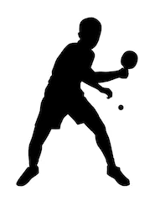

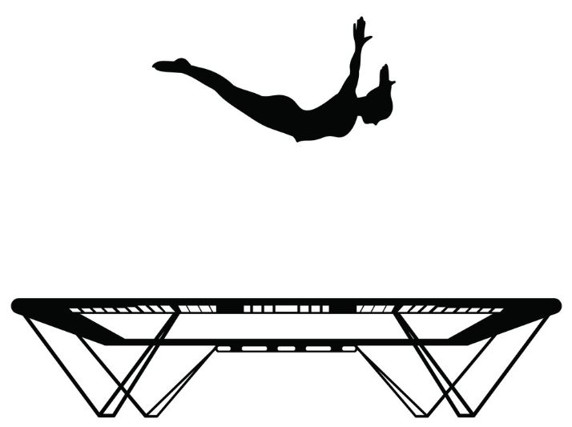



Core PE Learning Journey
Key Stage 3 & 4
Understading and Applying Scientific Skills
Year 7
Thematic Approach to PE
Year 11
Fitness/Yoga
Netball
Basketball
Football
Team Building
Table Tennis
Football
Fitness/Yoga
Table Tennis
Rugby
Netball
Football
Options
Rugby
Team Building
Options
Cricket
Lifestyle Choices
Highly Skilful
Effective Thinker
Empowered Character
Team Building
Basketball
Football
Developing a healthy active lifestyle
Selecting appropriate activities for well being
Preparing for life after school
Self-management (physical activity and health)
Self-management/personal motivator
Leading and organising
YEAR
11
Rounders
Cricket
Athletics
Table Tennis
Team Building
Rugby
Highly Skilful
Effective Thinker
Empowered Character
Table Tennis
Football
Netball
Rugby
Tackling complex activities
Creating a personal healthy active lifestyle
Experiencing new challenges
Developing independence
Transferring knowledge
Developing officiating skills
Understanding how to motivate individuals/teams
Demonstrating resilience as an individual/ team
Introduction to organising competition
YEAR
10
Team Building
Basketball
Football
Fitness/Yoga
Basketball
Netball
Football
Football
Fitness/Yoga
Team Building
Table Tennis
Rounders
Cricket
Highly Skilful
Effective Thinker
Empowered Character
Select & transfer skills
Fitness to enhance performance
Demonstrate tactic & strategies
Decision making
Knowledge of Rules
Performance analysis
Roles within teams
Demonstrate resilience
Performance improvement through leadership
Athletics
Table Tennis
Team Building
Rugby
Netball
Football
Table Tennis
Rugby
Football
Fitness/Yoga
Team Building
Table Tennis
Fitness/Yoga
Netball
Basketball
Football
Team Building
Basketball
Football
Highly Skilful
Effective Thinker
Empowered Character
Adapt and apply Skills
Fitness levels & knowledge
Tactics & strategies knowledge
Create and plan activities
Rules
Evaluate performance
Communication in teamwork
Resilience
Effective leadership
YEAR
9
8
YEAR
8
Rounders
Cricket
Netball
Dance
Football
Gymnastics
Gymnastics
Netball
Dance
Football
Football
Gymnastics
Team Building
Table Tennis
Table Tennis
Football
Gymnastics
Rugby
Team Building
Rugby
netball
Athletics
Rounders
Cricket
Highly Skilful
Effective Thinker
Empowered Character
Skill level
Fitness levels
Tactics & strategies
Skill evaluation
Importance of exercise
Identify creativity
U
Teamwork
Confidence
Leadership
Athletics
Gymnastics
Netball
Dance
Football
Netball
Dance
Football
Gymnastics
YEAR
Team Building
Rugby
Netball
Table Tennis
Football
Gymnastics
Rugby
Football
Gymnastics
Team Building
Table Tennis
7

