Slide 1








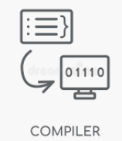









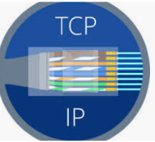






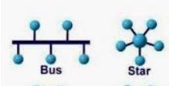










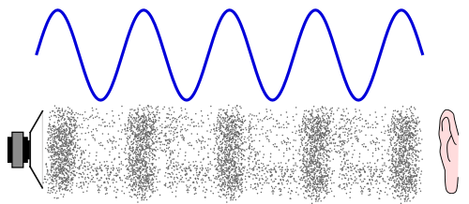

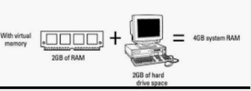

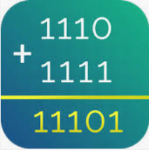






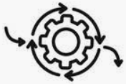







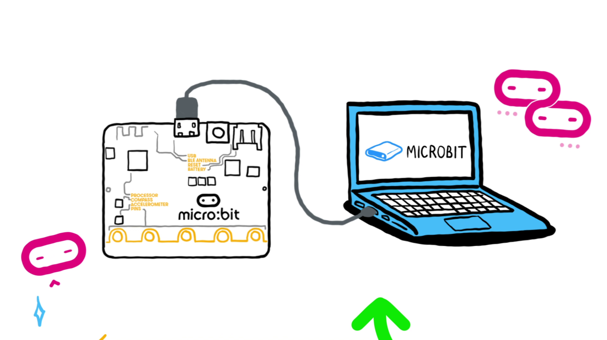
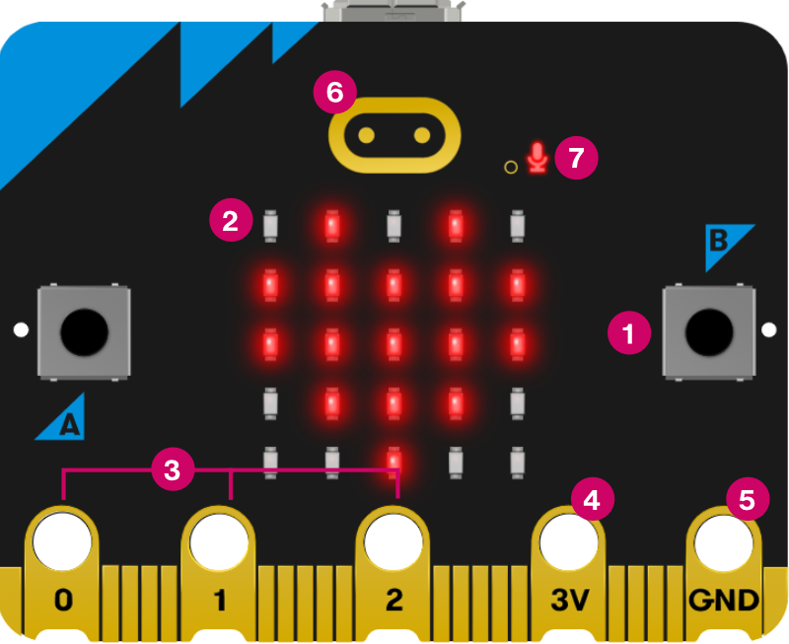

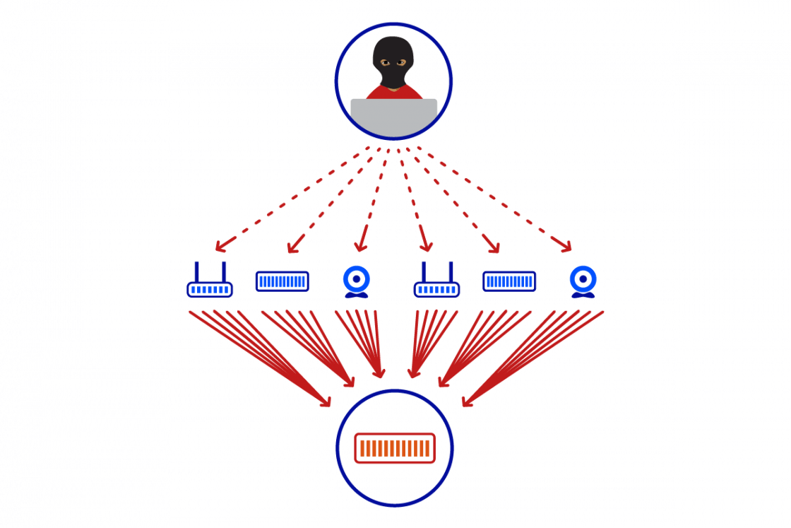
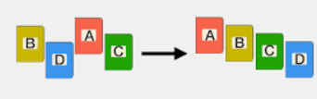


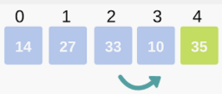
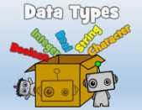
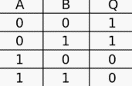











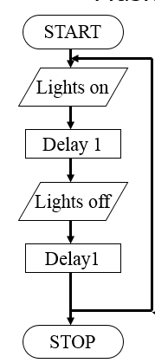
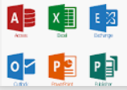
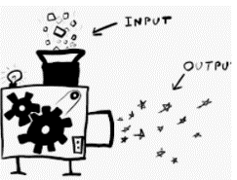
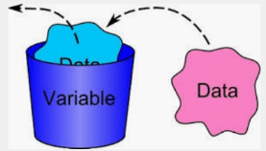


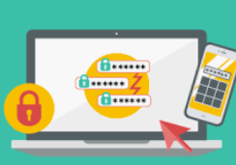

Computing Science Learning Journey
Year 7
Understanding and Applying Computing Skills
Year 11
Understanding how to keep safe online
Understanding roles of components within Computer architecture
Working with Data and logic
Understanding Data representation
Computer connections and protocols
Recommend and analyse Network security
Developing computational thinking
Developing Programming skills
Knowledge of Systems and networks
Comparing Memory and storage
Understanding programming lanaguages
Evaluating Ethical, legal, cultural and environmental
impacts of digital technology
Explain the role of peer to peer and client server networks?
Discuss benefits and drawbacks of using a compiler or an
interpreter
purpose of each piece of legislation
Give examples of digital technology
Discuss environmental issues
What's the cloud?
Why are translators needed?
Logical errors
Describe hosting?
networking
Programming languages and Integrated
Development Environmentss
Ethical, legal, cultural and environmental impacts of digital technology
Exam & Post – 16
Destination
Syntax errors
What are Ethical issues?
Describe different transmission media?
Types of compression?
Describe the characteristics of a compiler and an interpreter
Discuss differences between high- and low-level programming
languages
Discuss types of Legislation
Discuss the impact of technology
Understand Maintainability
Describe authentication
Producing robust programs
Why use sub programs?
How IDE tools are used
Types of Testing
Protocols
Explain TCP/IP stack
Threats
What’s the round function?
Implement
YEAR
Name Layers
WAP
How to use Validation
Programming project
11
Computer networks, connections and
protocols
Network security
File handling
How to design a program?
Programming techniques
Boolean expressions?
Analysis
Evaluate
Discuss pros/cons of the Mesh network?
Discuss pros/cons of the Star network?
Identifying and preventing vulnerabilities
SQL?
Explain what effects CPU performance
Random generator
Nested selections?
Vector and bitmap
What is the task of the MDR?
What the role of the MAR?
What’s the purpose of RAM
Design using Pseudocode
Produce Flowcharts
Binary shift
Resolution
YEAR
ROM
10
Systems Architecture
Memory
Algorithms
Data representation
Sampling rates
Data representation sound/image
What’s a check digit?
Pixels
What’s the purpose of the Program Counter?
Accumulator
Why is virtual memory needed?
Search
Sort
Create Trace tables
Binary addition
Legislation
Sequence
Computational thinking
Logos
Society
Ethics
Purpose of Utility programs
Photoshop
Layers
Use Iteration
Profit/Loss
Cash Flow
Malware
Privacy issues
Photo Editing
Microbit programming
Business
plans
Cyber Security
Social engineering
Sustainability
Graphics
Selection IF/ELSE
What’s the difference between a for and while loop?
How do you solve problems?
Boolean operators
Bots
Filters
Layers
DDOS
YEAR
User input
9
Cells
Searching data
What’s Linear search?
sequence
Iteration
CPU
Memory
Bias
Decision trees
Boolean logic
YEAR
Web Design
8
Searching/Sorting algorithms
Textual programming
Systems architecture
AI and
Digital footprint
Logic
Navigation
Charts/Graphs
Digital graphics
Master page
Data Modelling
Sorting data
What’s bubble sort?
Name 4 data types?
Selection
Input/process/output
Embedded systems
Training models
What’s a Truth table?
How to draw a logic Diagram
formula
school network
What’s hardware and software?
What is binary?
Visual programming
Algorithm thinking
GDPR
open/close/edit/save files
How computers work
Abstraction
Cyberbullying
YEAR
What’s an output?
Binary representation
Block Programming
Computational thinking
E-safety
Getting started
7
What’s an input?
Character set
Denary
What is a variable?
What is a flowchart?
Pattern recognition
What is personal data?
Define malicious programs
What’s a secure password?
Use range of applications.
ASCII
Decomposition

