Slide 1






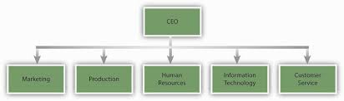





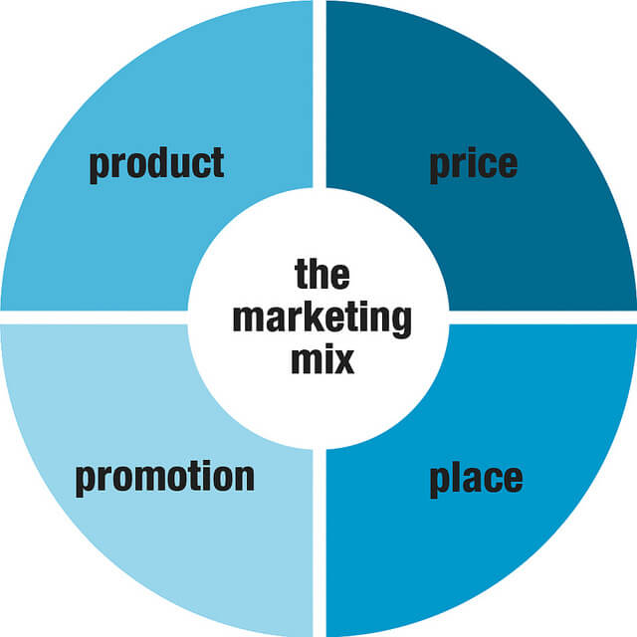

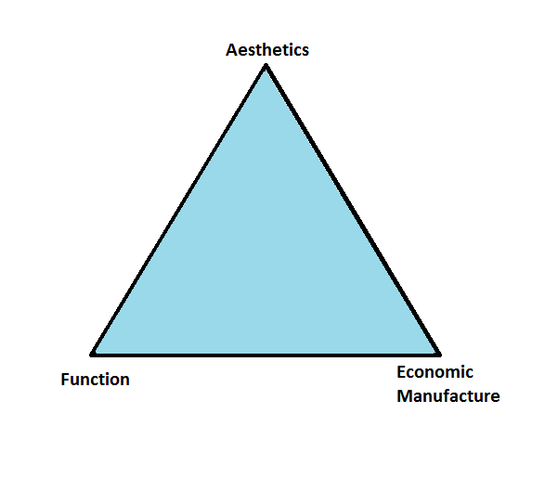




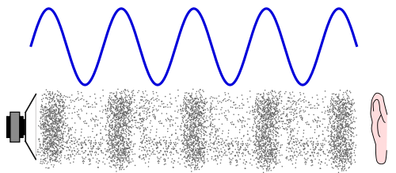




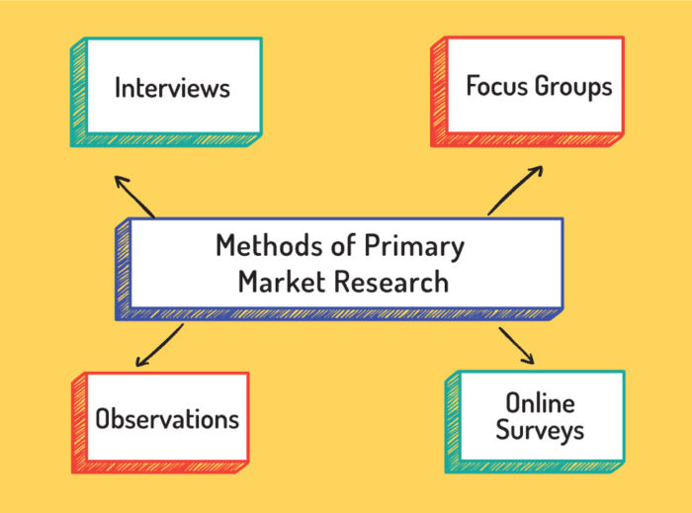



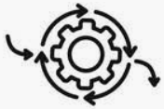






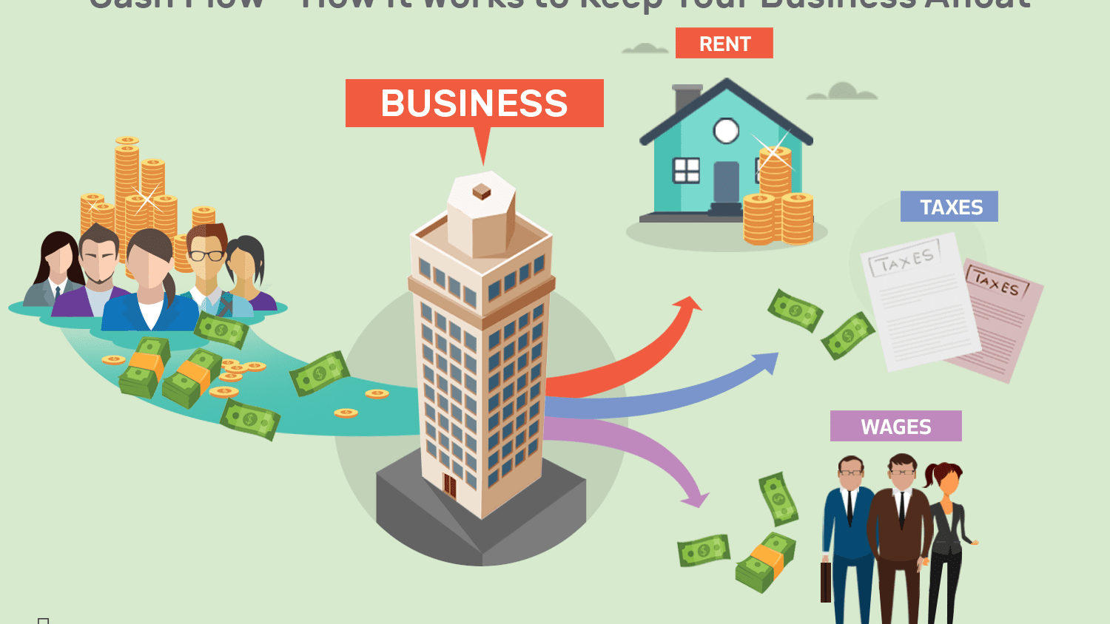

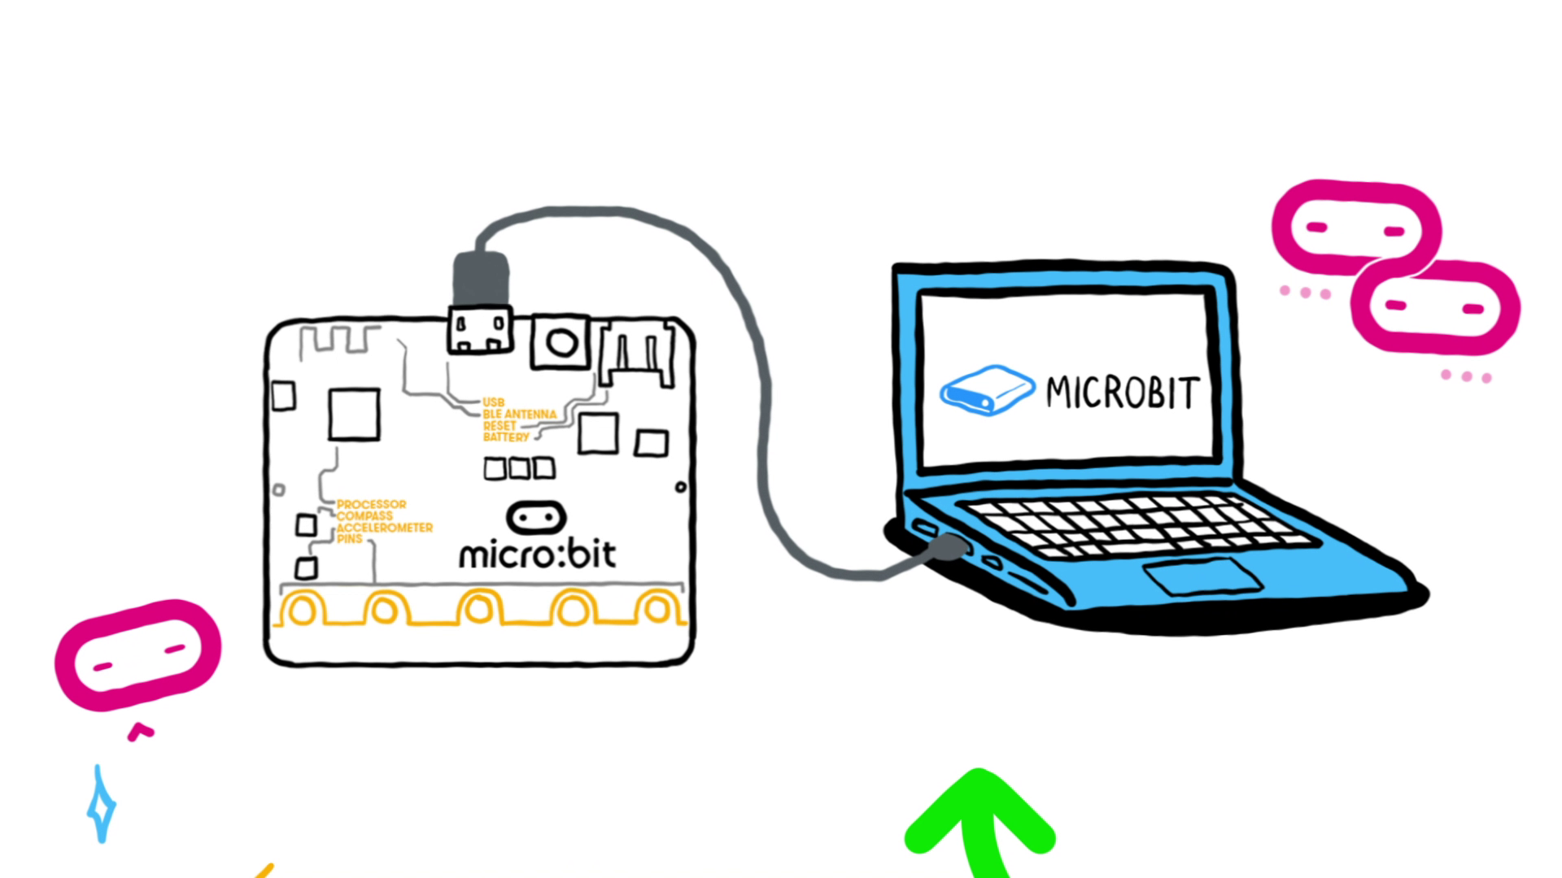
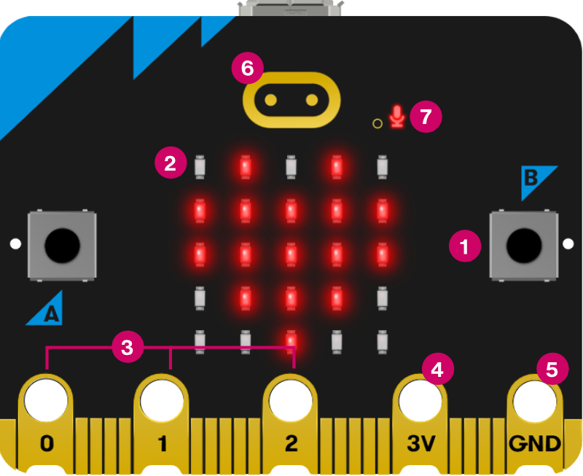

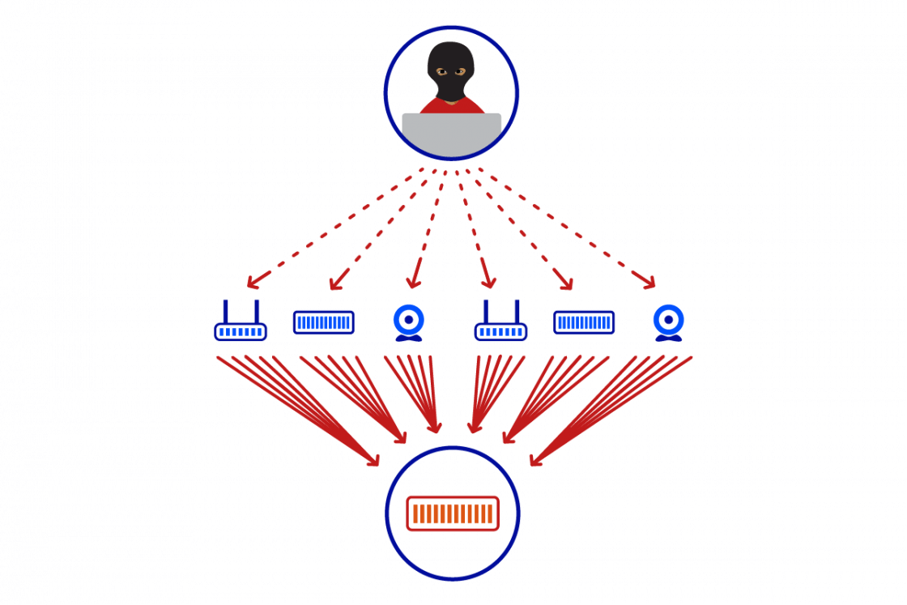
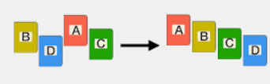


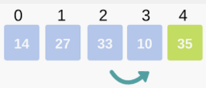

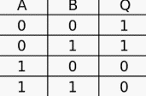











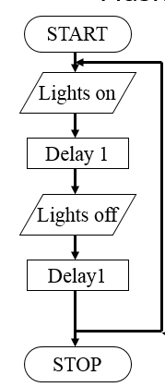

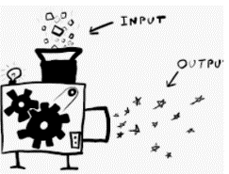
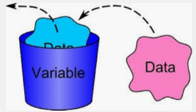


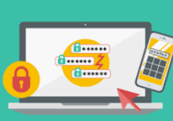

Business Studies
Learning Journey
Year 7
Understanding and Applying Business Skills
Year 11
Entrepreneurial skills
Putting a business idea into place
Understand external influences on business
Making marketing decisions
Understand business calculations including inflows and outflows
Spotting a business opportunity
Making a business effective
Operational decisions
Financial and human resource decisions
Growing a business
Limited and unlimited liability
Effective communication
Different ways of working
Effective training and development
How businesses motivate employees
Business calculations –
Gross and Net profit
Business location
Exam & Post – 16
Destination
The role of procurement
Making the business effective
Financial and human resource decisions
Working
with suppliers
Organisational structures
Business plans
Hierarchical or flat
Centralised or decentralised
Effective
recruitment
Job
documentation
Internal and external recruitment
Operational decisions
Managing quality
Market segmentation
Competitive environment
Extension strategies
Product life cycle
How businesses compete internationally
Using the marketing mix to make business decisions
The sales process
YEAR
Pricing strategies
11
Spotting a business opportunity
Making marketing decisions
Tariffs and trade blocs
Production process
Job
Bath
Flow
The Design Mix – Function /Aesthetic/cost
Changes in business aims and objectives
Market mapping
Place:
retailers and e-tailers
Business operations
Promotion
Sources of finance
Business and globalisa-tion
Impact of legislation on Business
The economy and business
Growing the business
LTD and PLC companies
Business stakeholders
Products and services
Business success
Technology and business
external growth
Vector and bitmap
YEAR
Risk and reward
Employment law
YEAR
10
Resolution
10
Enterprise and entrepreneurship
Understanding external influences on business
Internal growth
Data representation sound/image
How a business idea comes about?
Role of business enterprise
Inflation
Changes levels of consumer income
Sampling rates
Legislation
External influence
Logos
Options for start up and small businesses
Sequence
Computational thinking
Profit/Loss
Cash Flow
Society
Ethics
Purpose of Utility programs
Photoshop
Layers
Use Iteration
Malware
Privacy issues
Ethics
Photo Editing
Microbit programming
Business
plans
Cyber Security
Social engineering
Sustainability
Graphics
Selection IF/ELSE
What’s the difference between a for and while loop?
How do you solve problems?
Boolean operators
Bots
Filters
Layers
DDOS
YEAR
9
YEAR
9
Searching data
What’s Linear search?
Iteration
User input
CPU
Memory
Bias
Training models
Boolean logic
Cells
YEAR
sequence
8
Searching/Sorting algorithms
Textual programming
Systems architecture
AI and
Digital footprint
Logic
Web Design
Navigation
Charts/Graphs
Digital graphics
Master page
Data Modelling
Sorting data
What’s bubble sort?
Name 4 data types?
Selection
Input/process/output
Embedded systems
Decision trees
What’s a Truth table?
How to draw a logic Diagram
formula
school network
How computers work
What’s hardware and software?
What is binary?
Visual programming
Algorithm thinking
Cyberbullying
GDPR
open/close/edit/save files
Abstraction
YEAR
Binary representation
Block Programming
Computational thinking
E-safety
Getting started
7
What’s an output?
What’s an input?
Character set
Denary
What is a variable?
What is a flowchart?
Pattern recognition
What is personal data?
Define malicious programs
What’s a secure password?
Use range of applications.
ASCII
Decomposition

